Slide 1

CFA Institute
Research Challenge
2025-2026
CFA Society New York Kickoff meeting

Slide 2
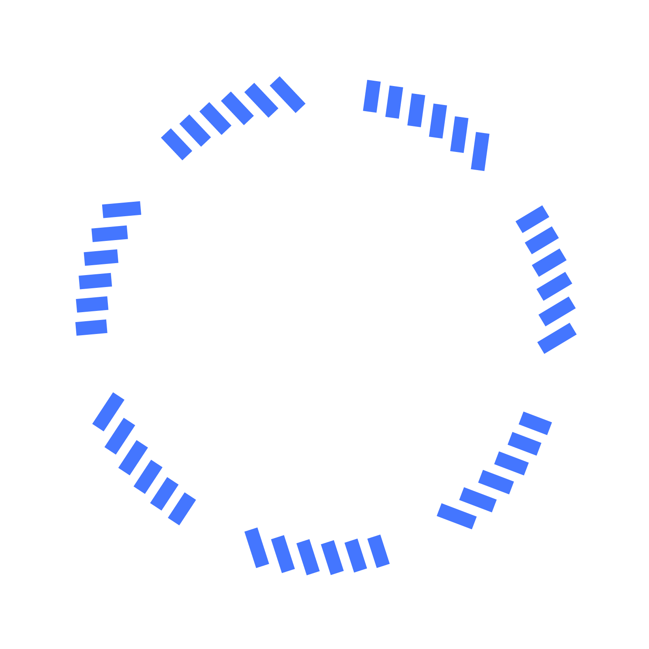
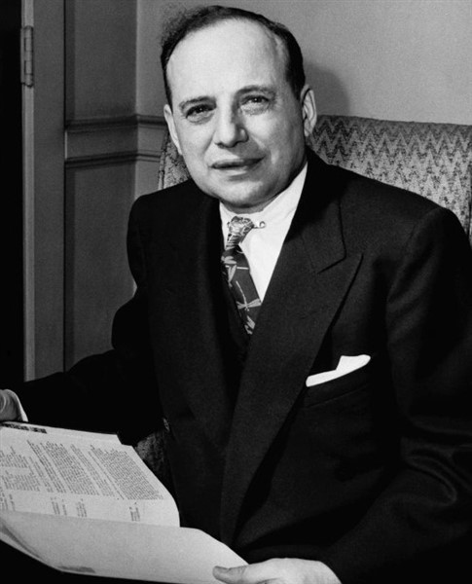
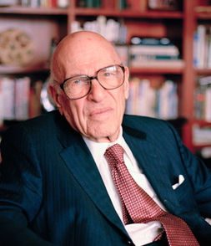
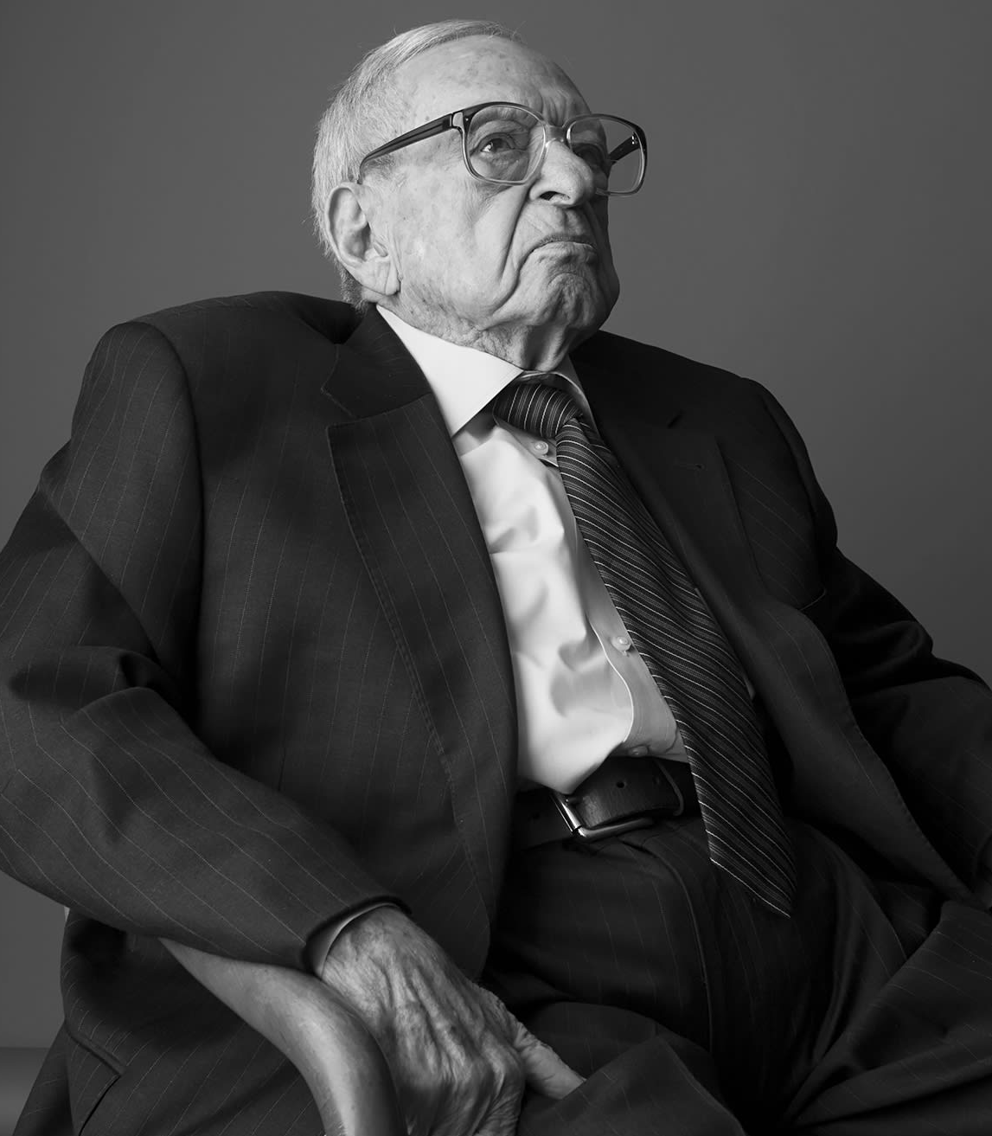

CFA Society New York has consistently served as a premier platform for the investment community. It was established in 1937 by a distinguished circle of professionals, including the Benjamin Graham, Walter Schloss, and Irving Kahn.
CFA Society New York holds the distinction of being a charter member society of CFA Institute and proudly stands as an inaugural contributor to the Research Challenge
Thank you to our partnership with:

Slide 3



Points of Contact
Paul Attard pattard@cfany.org
Enrique Ramos eramos@cfany.org
3

Slide 4
The CFA Exam
Overview
Julia Orlich, IMC | Director, Partnerships & Client Solutions, Americas | CFA Institute

Slide 5

The Heloise Ham Scholarship Fund
Marya Savola, Leo Schmidt, Arthur Fleigalman, The Graham Center Committee

Slide 6
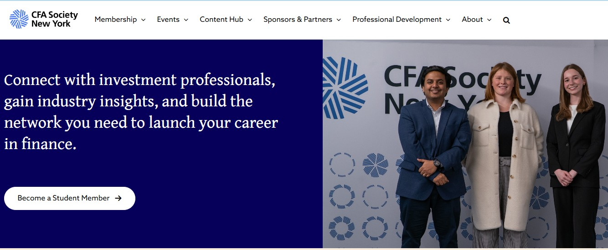
Student Membership
CFA Society New York

Slide 7
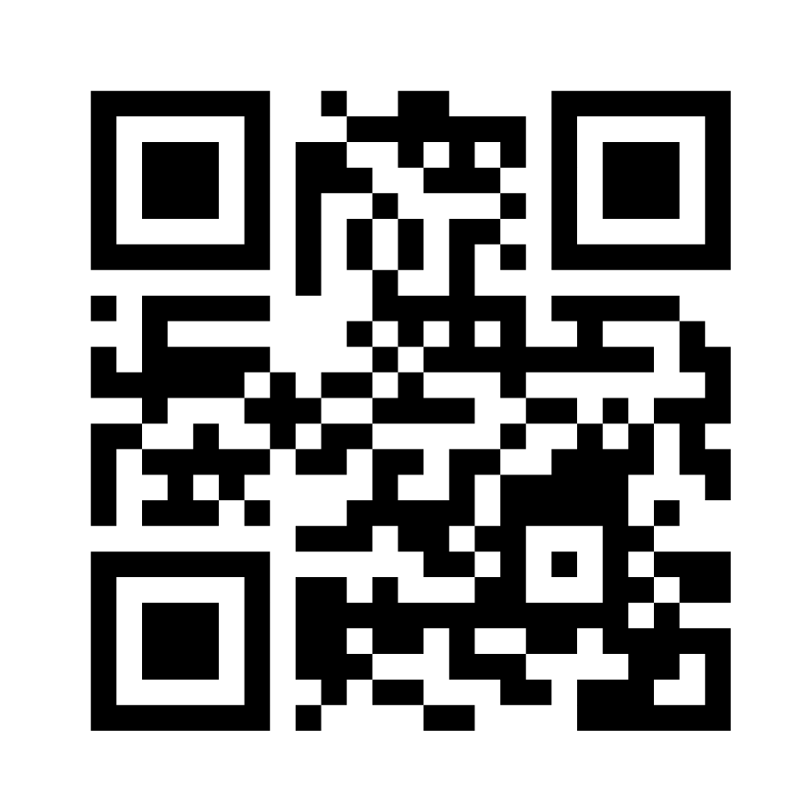

Upcoming CFA Society New York Events
What’s New in International Financial Reporting?
Wednesday, November 12 | 6:00 PM - 7:30 PM
2025 Fall Employment Outlook
Wednesday, November 19 | 5:30 PM - 8:00 PM
CFA Society New York Lunch & Learn Series
Thursday, November 20 | 12:00 PM - 1:00 PM
CFA Society New York Coffee Chat Series
Tuesday, December 9 | 8:00 AM - 9:00 AM
CFA Exam Level 2 Review: CFA Society New York and Kaplan Schweser
Thursday, January 22 | 6:0 PM - 8:00 PM
Scan for full
event calendar

Slide 8
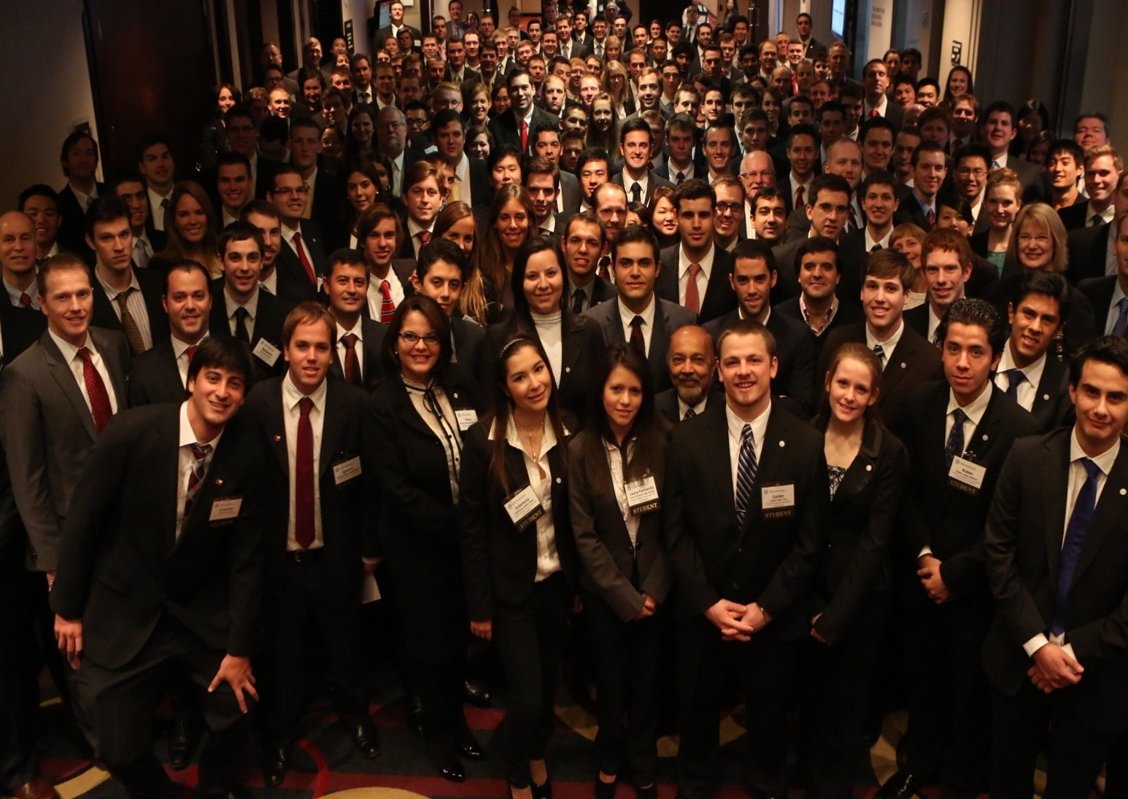
2025-2026 Research Challenge & Network
The Challenge
Global network of the world’s top business and finance students
The CFA Institute Research Challenge is an annual global competition that provides university students with hands-on mentoring and intensive training in financial analysis and professional ethics.
Each student will be tested on their analytical, valuation, report writing, and presentation skills. They gain real-world experience as they assume the role of a research analyst.
5,000+ Students
3,000+ Volunteers
900+ Universities
150+ CFA Societies
113 Local Challenges
91 Countries
© 2025 CFA Institute. All Rights Reserved.

Slide 9
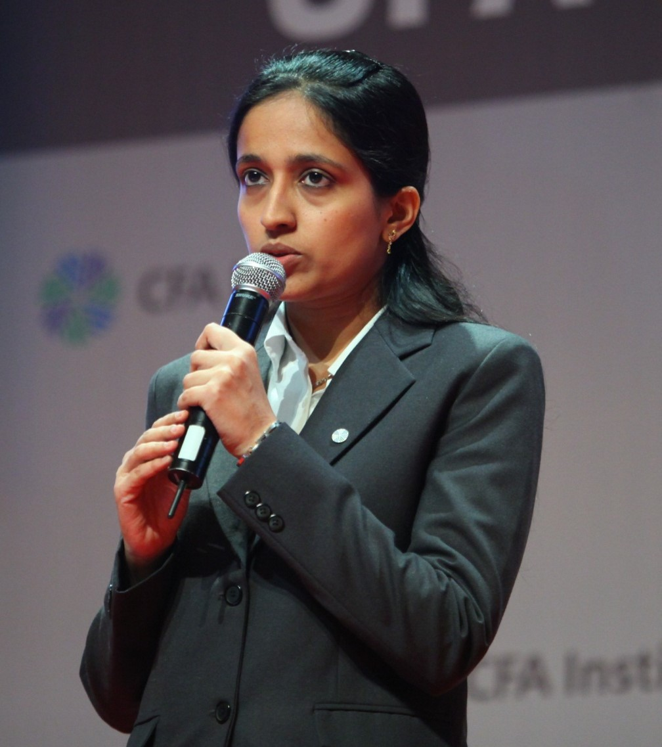
Team and Student Registration
All participants, including students, faculty advisors, industry mentors, graders, and judges, must register by logging into or creating a CFA Institute account and should use the designated Volunteer link for sign-up.
Students will see an optional “Team Name” box during registration – please use your University name here.
Universities with more than one team will use A & B. After registration we will give you a Team Name based on entry date.
Register for the competition on the CFA Institute registration portal by Nov 21
  Students will receive a welcome letter
  Faculty and volunteers will receive confirmation from us
  We will provide access to our Research Challenge Site
      Watch videos of past presentations
      View past reports from winning teams
      Eligibility standards
      Review the rules
      Kickoff Video
9

Slide 10
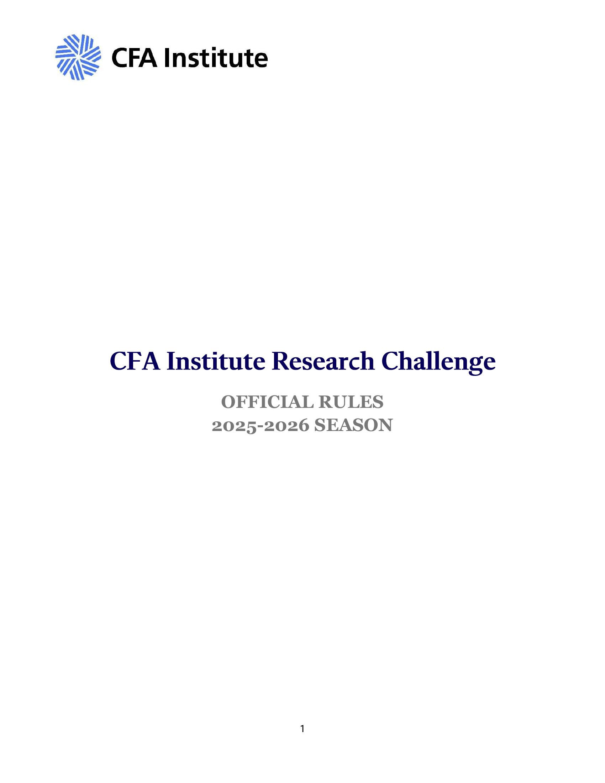
Rules
CFA Institute Research Challenge
The official rules for this year’s competition can be found here
It will contain:
  Official competition rules
  Written report guidelines
  Presentation guidelines
  Ethics and code of conduct
  Written report format

Slide 11
Faculty Advisor & Industry Mentor Involvement
CFA Institute Research Challenge
Faculty Advisors
Industry Mentor
Insight and guidance on research methods and tools as taught in academia
10 hours maximum of productive time
Access to faculty for other projects unrelated to the Research Challenge is permitted
Insight and guidance on industry practice
6 hours maximum of productive time
Face to face or virtual
Review first draft of research report
Presentation development assistance

Slide 12
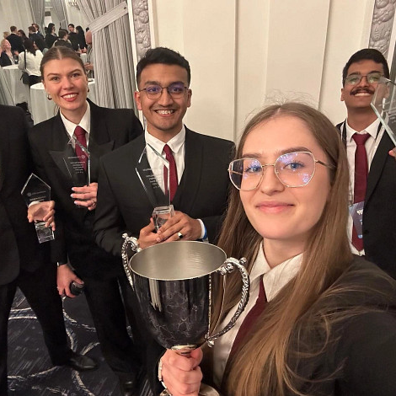
Kozminski University
Subject Company: Dom Development
2024-2025 Global Champions
CFA Society Poland

Slide 13


















Participating Universities 2025
Notes:
Explain the 24 team rule

Slide 14
Sample Report

Slide 15
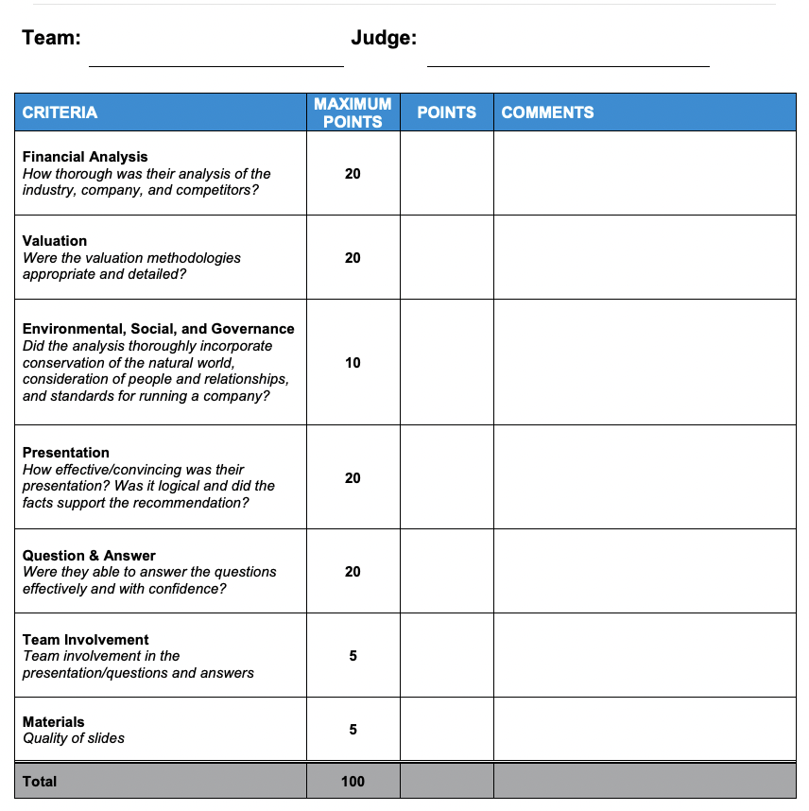
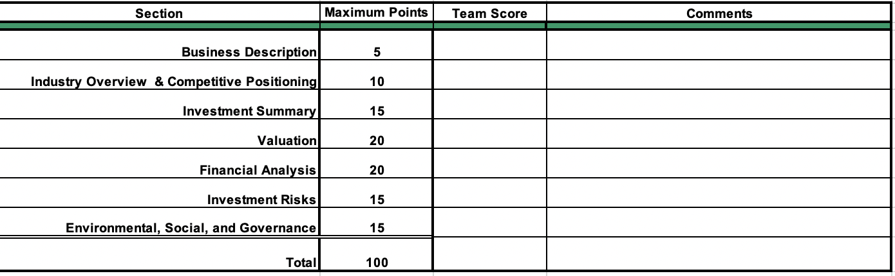
Scoring
Research Report Scoring
Presentation Scoring
15

Slide 16
And the subject company is…..

Slide 17

Nano Nuclear Energy Inc
Subject Company
Founder: Jay Jiang Yu, 2021
NASDAQ: NNE
Industry: Nuclear energy company
Recent Close: $45.24
Recent Market Cap: 1.82B

Slide 18

Interacting with Nano Nuclear Energy Inc.
Designated officers ONLY
Organized communications ONLY
  To be scheduled for next month
Industry mentor OR faculty advisor may be present for all student-subject company interactions
Students may contact and survey company suppliers, customers, vendors, etc.
Please keep information confidential
Replay of the Q&A will be available and sent to you

Slide 19
Competition Timeline
Oct/Nov
Dec/Jan
Feb
Feb/March
31st
Nov4th
21th
3rd
19th
Jan 19th
9th
17th
19th
24nd
26th
March 1st
Oct 31- University Registration
Nov 4 - Kickoff Meeting
Nov 21 - Student/Faculty Due
Dec 3 - Q&A with Nano Nuclear Energy Inc.
Dec 19 - Last day to make substitutions or additions
Jan 19- Reports Due
Feb 9 - Reports returned (teams narrowed down)
Feb 17- Presentations Due
Feb 19- Round 1 of Presentations
Feb 24- Round 2 of Presentations
Feb 26- Final Round- Winner Chosen
March 1- Winners move on to the regionals

Slide 20

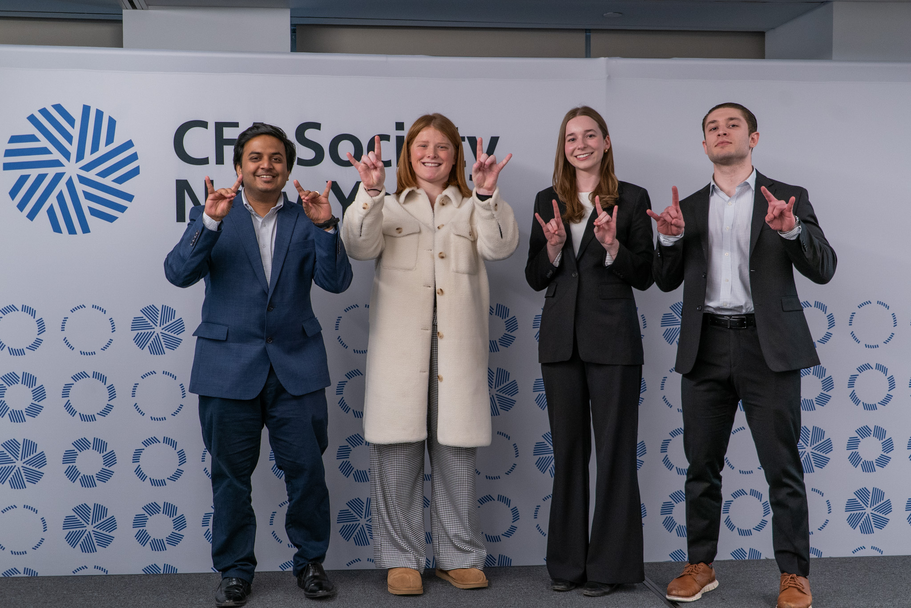
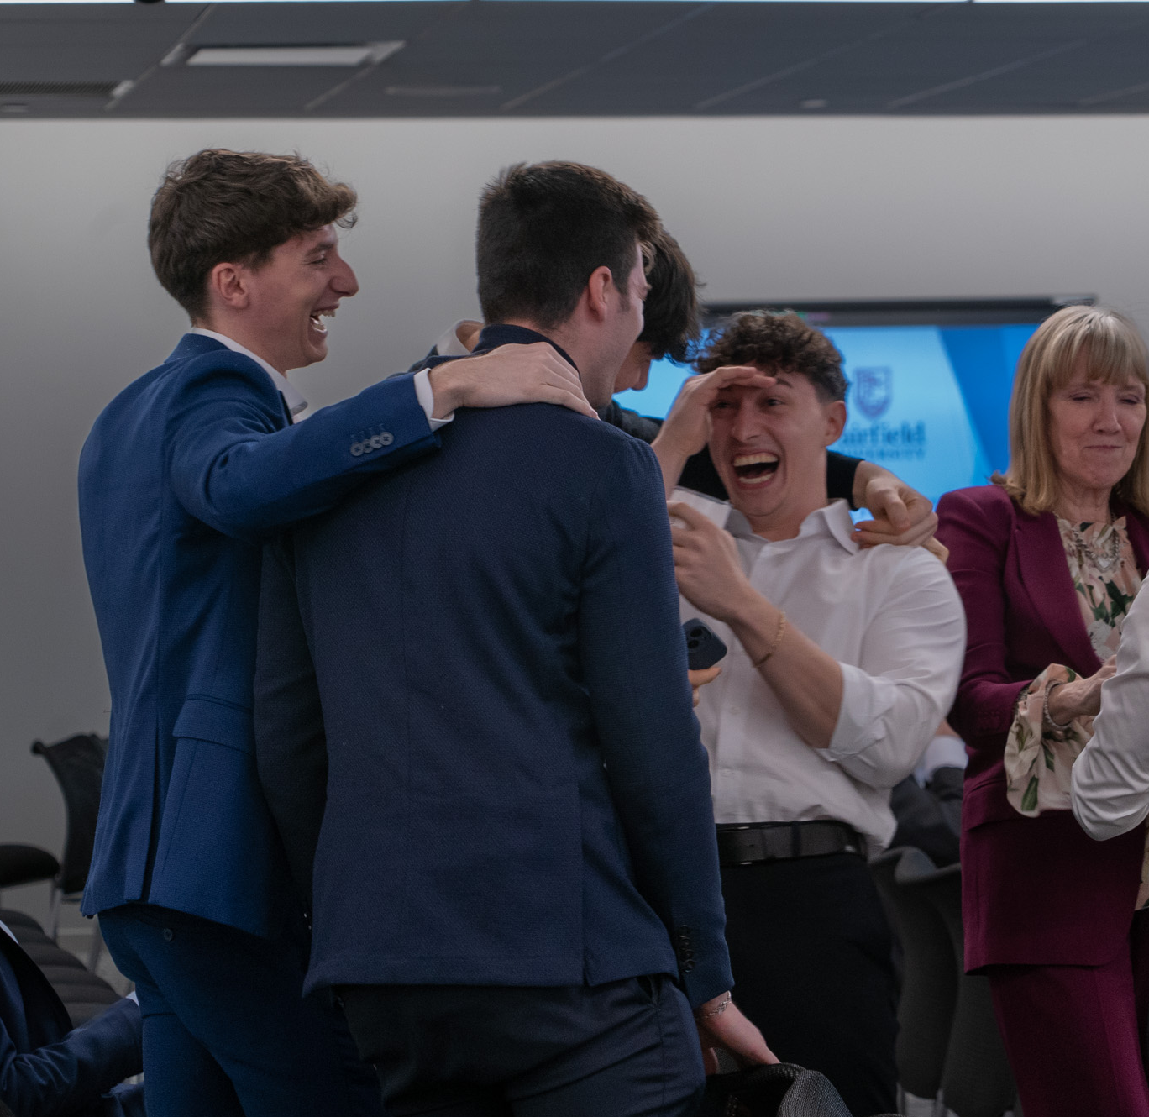
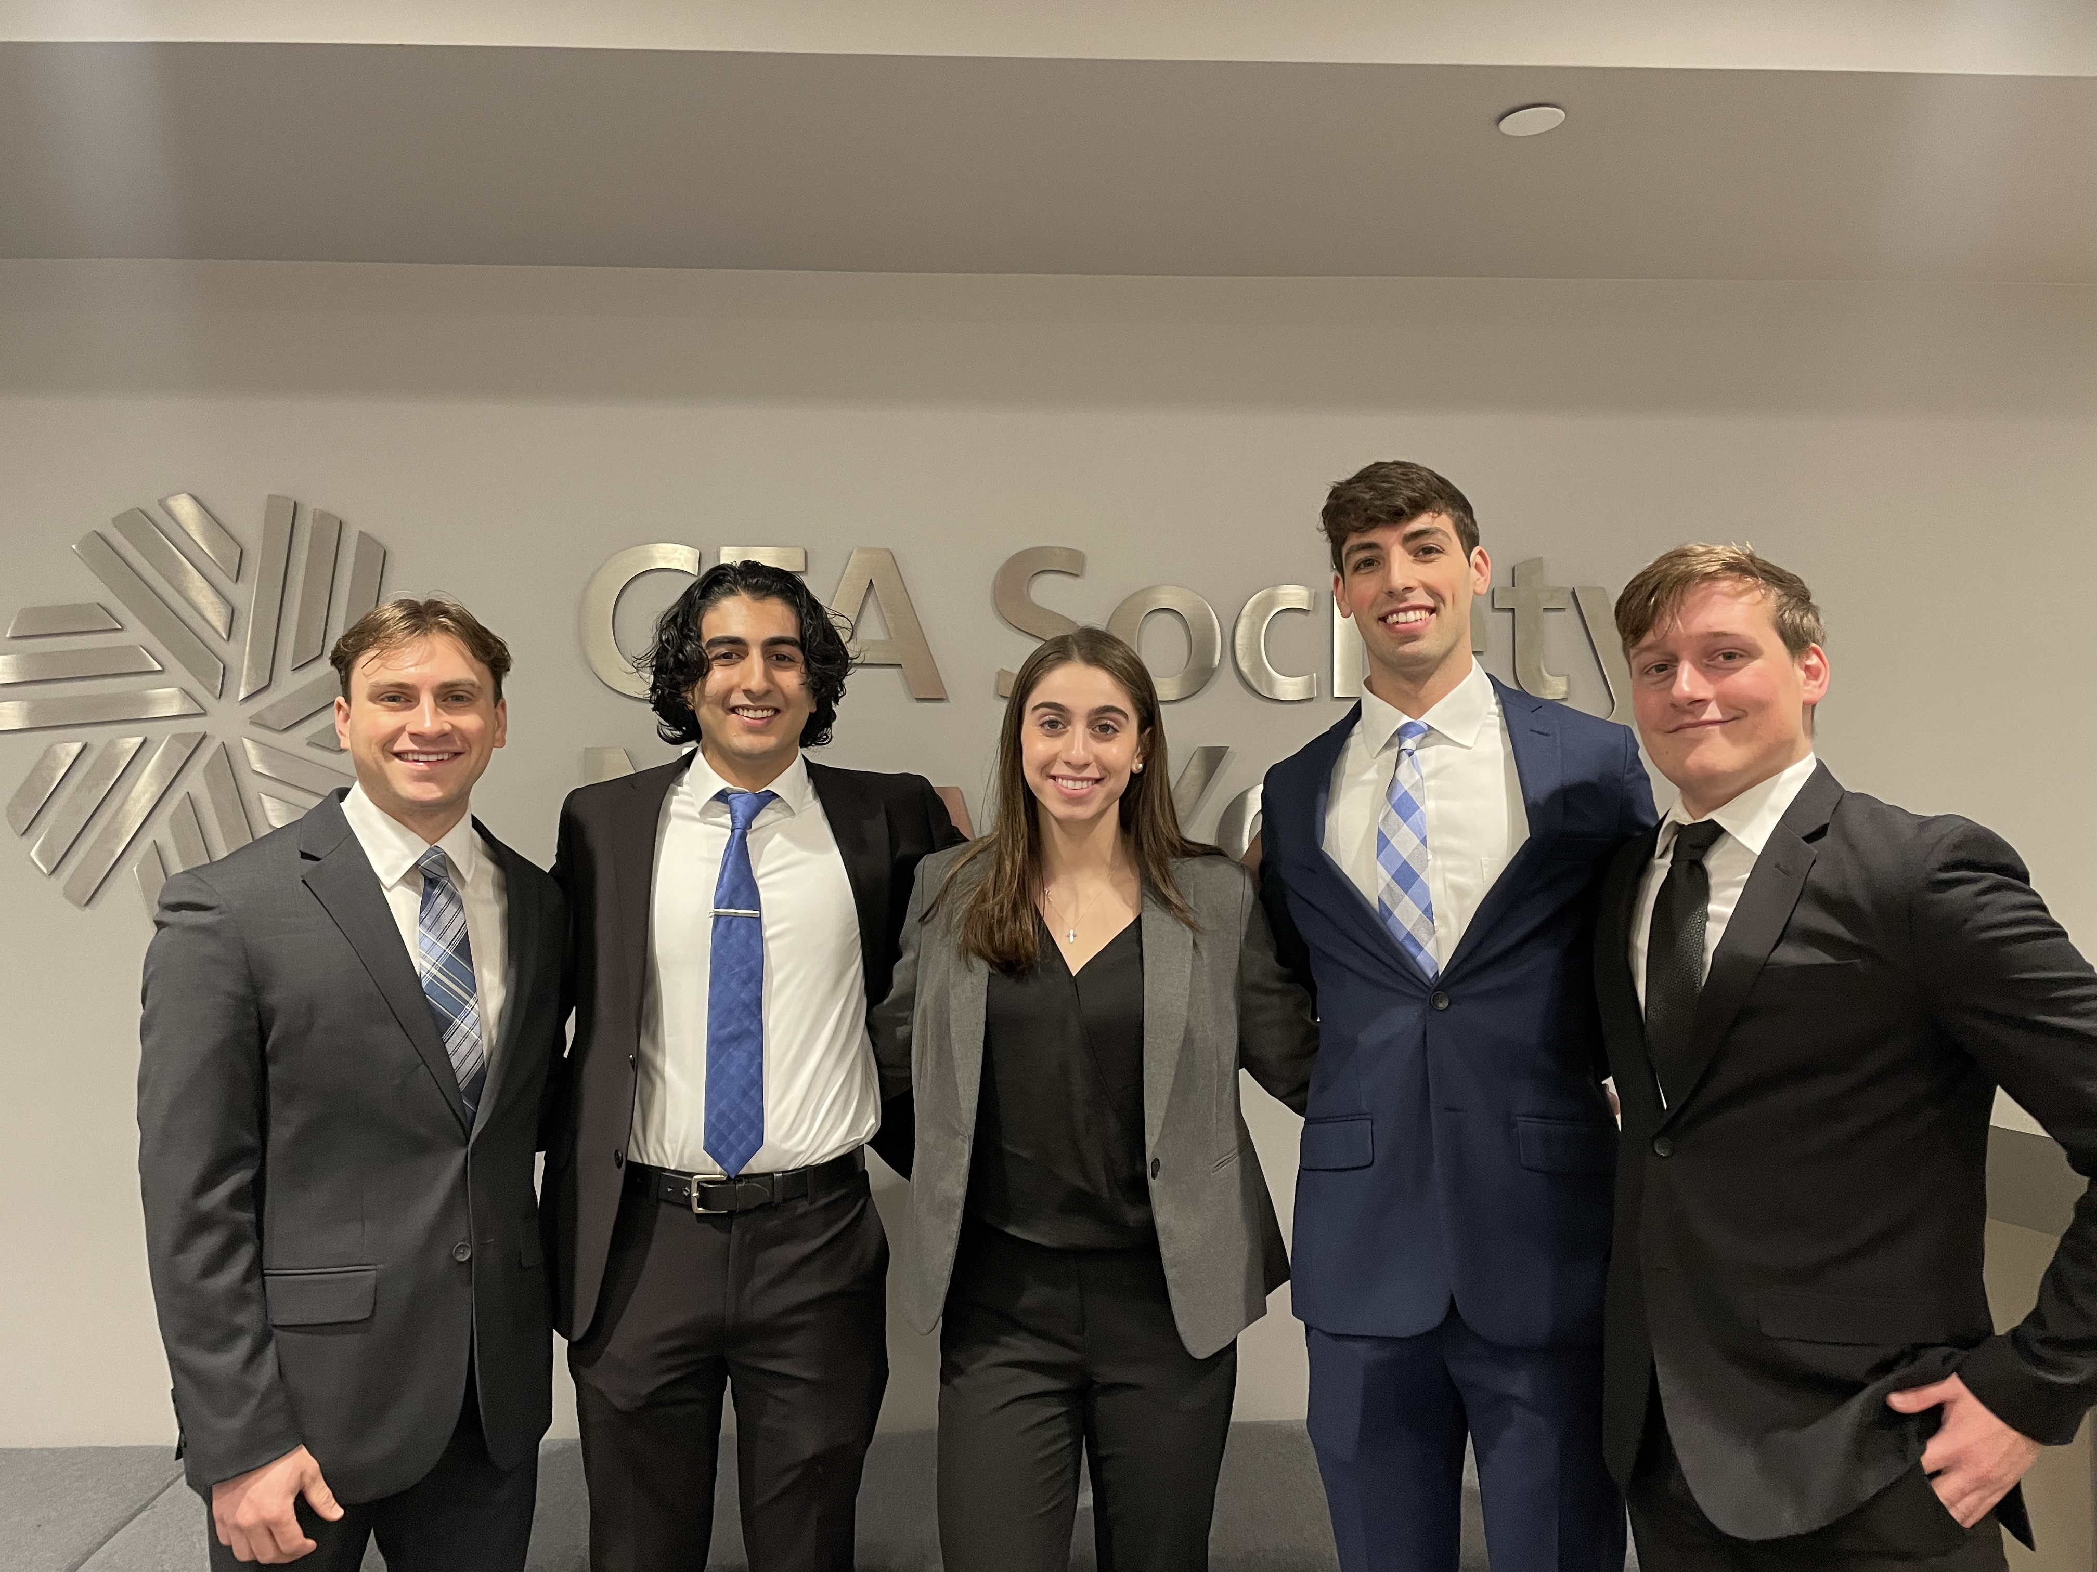
Thank you to all students, faculty, and volunteers
This could be you!
This could be you!

Slide 21
Questions?

