Slide 1
CFA® Institute
welcome

Slide 2
Today’s agenda
CFA Institute
CFA Program Overview & Enhancements
Q&A

Slide 3
CFA® Institute
Overview

Slide 4


A Unique Force Within the Investment Profession
A global not-for-profit organization.
The world’s largest association of
investment professionals.
Industry leaders promoting the highest standards of ethics, education, and professional excellence.
A vast global network of members, societies, and relationships with key financial organizations around the world.
CFA Institute Mission
To lead the investment profession globally by promoting the highest standards of ethics, education, and professional excellence for the ultimate benefit of society.
4

Slide 5
Membership, Candidates, and Societies
Americas 57%
Members > 113,000
CFA Program Candidates > 50,070
Societies: 92
EMEA 22%
Members > 47,000
CFA Program Candidates > 40,595
Societies: 47
Data as of July 2025
In the mainland of China, CFA Institute accepts CFA Charterholders only.
Asia Pacific 21%
Members > 44,000
CFA Program Candidates > 117,560
Societies: 19
158 local societies
More than 205,000 members in 158 markets
© 2025 CFA Institute. All Rights Reserved.

Slide 6
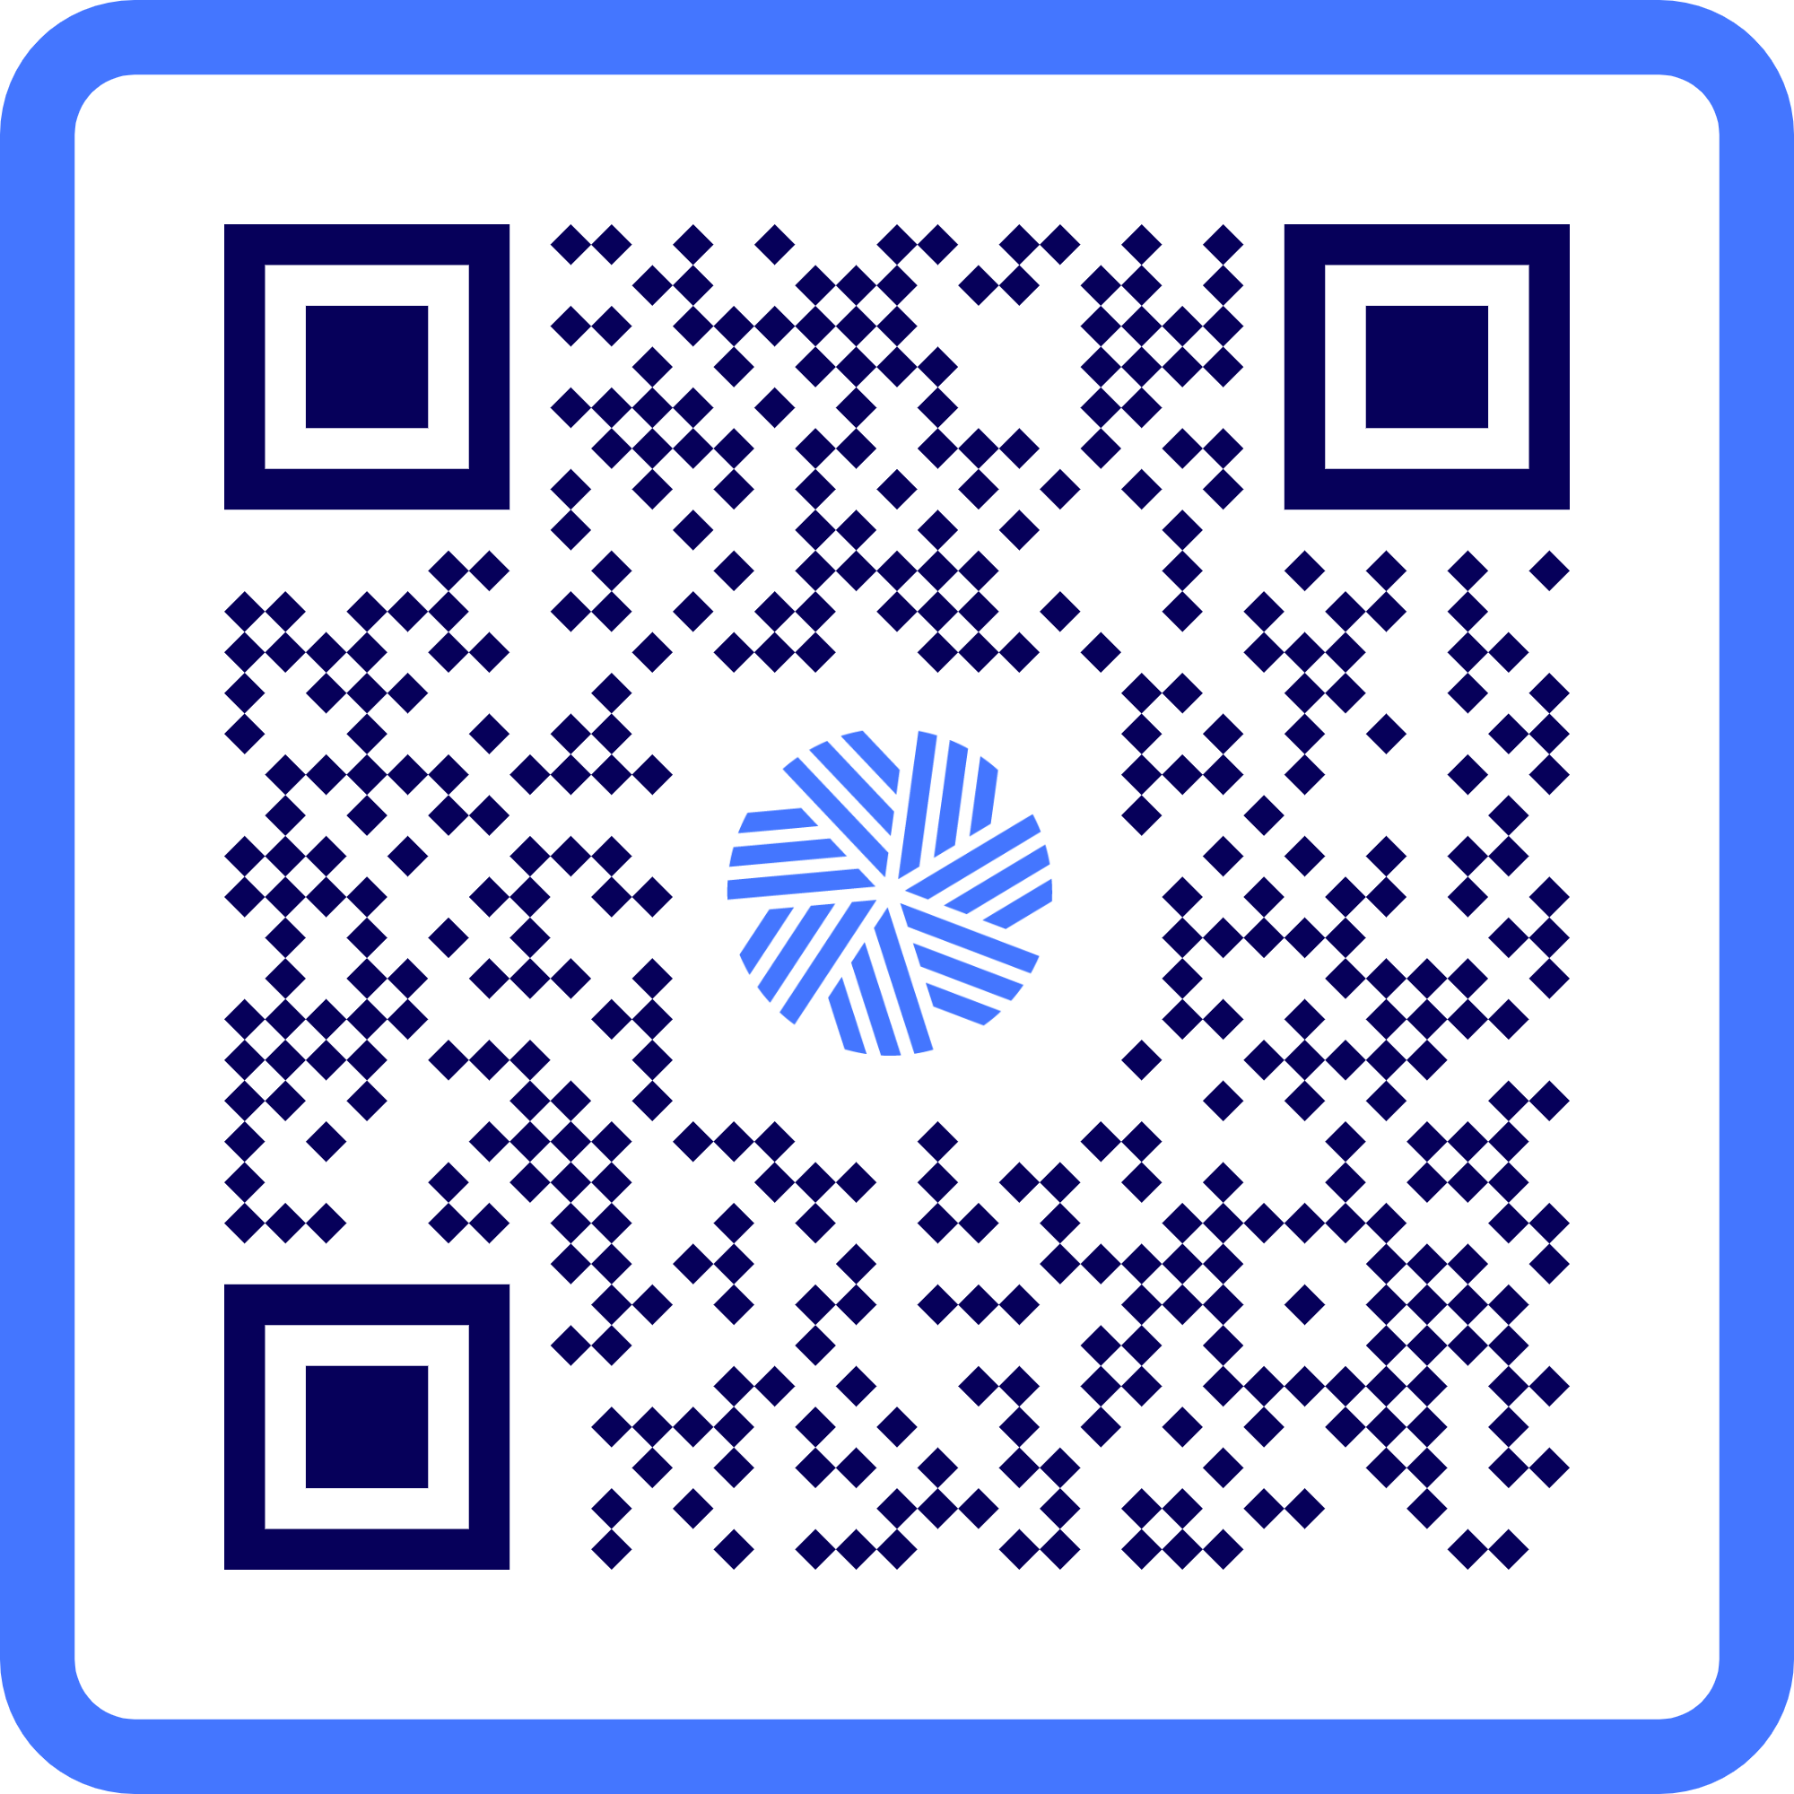
Where do they work?
Rank | Company | Number of CFAs on staff
1. | JPMorgan Chase | 2,582
2. | RBC | 2,532
3. | UBS | 2,159
4. | Bank of America | 1,680
5. | Morgan Stanley | 1,640
6. | TD Bank | 1,481
7. | HSBC | 1,424
8. | BlackRock | 1,365
9. | Citigroup | 1,365
10. | Goldman Sachs | 1,329
See top 60 employers of CFA charterholders on

Slide 7
CFA® Program
Overview & Enhancements

Slide 8
Why pursue the CFA Program?
PRIMARY RESEARCH OF 309 CHARTERHOLDERS GLOBALLY IN FALL 2020
Signalling value / differentiation
in a competitive job market
Value for money
Pre-req for switching to the buy-side
Pursuit of broader,
more practical knowledge
Global recognition
Switching from the sciences
Already studied much of
the curriculum at school
Paid for by employer
Mandated by employer
Curriculum quality
Enhancing credibility with clients
Global mobility
Networking with Members

Slide 9
CFA® Program-2025 Curriculum
Knowledge/Comprehension
Application/Analysis
Synthesis/Evaluation
Ethics
Ethics
Ethics
Level I
Level II
Level III
Ethics and Professional Standards
Portfolio Management
Portfolio Construction
Derivative and Risk Management
Investment Tools
Asset Classes
  Quantitative Methods
  Economics
  Financial Statement Analysis
  Corporate Issuers
  Equity Investments
  Fixed Income
  Derivatives
  Alternative Investments
Asset Allocation
Performance Measurement
  Portfolio Management Pathway OR
  Private Markets Pathway OR
  Private Wealth Pathway
© 2025 CFA Institute. All Rights Reserved.

Slide 10
Curriculum topics
 | Topic Emphasis | CFA Level I | CFA Level II | CFA Level III
1 | Ethical and Professional Standards​ | 15-20 | 10-15​ | 10-15
2 | Quantitative Methods​ | 6-9 | 5-10​ | --
3 | Economics​ | 6-9 | 5-10​ | --
4 | Financial Statement Analysis​ | 11-14 | 10-15​ | --
5 | Corporate Issuers​ | 6-9 | 5-10​ | --
6 | Equity Investments | 11-14 | 10-15​ | --
7 | Fixed Income​ | 11-14 | 10-15​ | --
8 | Derivatives​ (Level I and II) Derivatives and Risk Management (Level III) | 5-8 | 5-10​ | 10-15
9 | Alternative Investments​ | 7-10 | 5-10​ | --
10 | Portfolio Management (Levels I and II) Portfolio Construction​ (Level III) | 8-12 | 10-15​ | 15-20
11 | Asset Allocation | -- | -- | 15-20
12 | Performance Measurement | -- | -- | 5-10
Pathway A | Portfolio Management Pathway | -- | -- | 30-35
Pathway B | Private Wealth Pathway | -- | -- | 30-35
Pathway C | Private Markets Pathway | -- | -- | 30-35

Slide 11



The Path to Becoming a CFA Charterholder
Pass Level I
Pass Level II
Pass Level III
Pass CFA
Exams
Acquire 4,000 hours qualified
professional work experience
Obtain 2 to 3 references
who attest to your work
New
Charterholder
Apply for
Membership
Meet Regular Membership Requirements

Slide 12
Computer-based testing OVERVIEW
Scheduling | Self-schedule in the exam window. Rescheduling of exam appointment within the same exam window is available for a fee.
Location | Proctored exams in 400+ locations globally, to include all locations that were offered in June paper-based testing.
Exam Length | Two 2¼ hour sessions with an optional break in between
Exam Format | Level I – 180 multiple choice questions Level II – 88 item set questions Level III – half constructive response and half item set

Slide 13
CFA® Program | Enhancements
Expanded program eligibility rules
Practical Skills Modules at each level
Focused curriculum
Optional extra practice questions and mock exams
Specialized Pathways for Level III
Digital Badges for Level I and Level II
© 2025 CFA Institute. All Rights Reserved.

Slide 14
Start your journey early
3+ YEARS away from Graduation | 2 YEARS away from Graduation | 1 YEAR away from Graduation | Post-Graduate
You’re just getting started on your academic journey, so now is the time to explore and set the direction for your university career | At this stage, you are getting closer to clarifying your finance career goals. | With one year left in school, there are more specific actions you can take — from courses to networking — that will jumpstart your finance career | Now that you’ve graduated, you can dive even deeper into advanced courses and more. Explore common finance roles even further by visiting our website

Slide 15
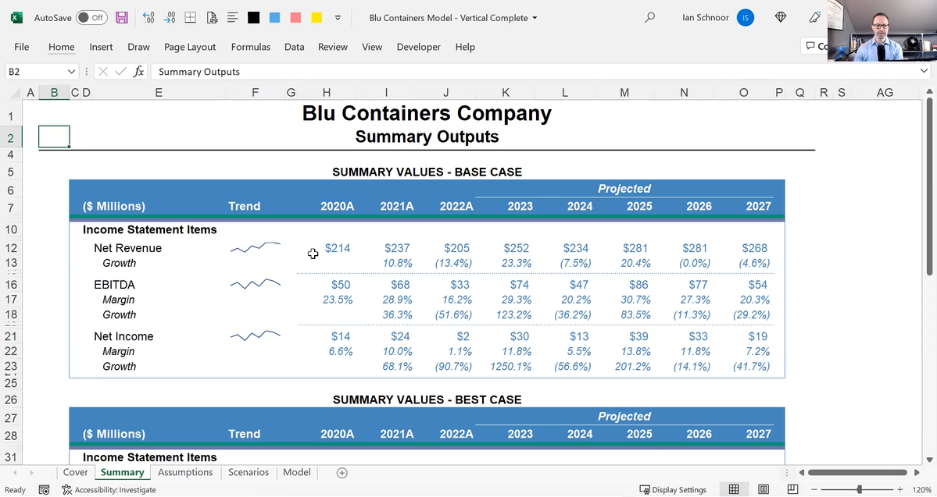
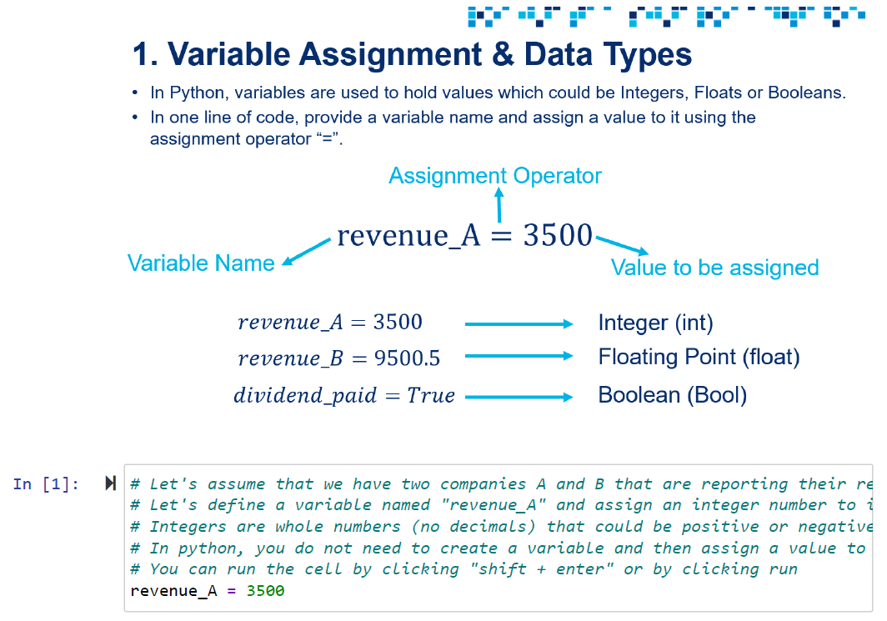
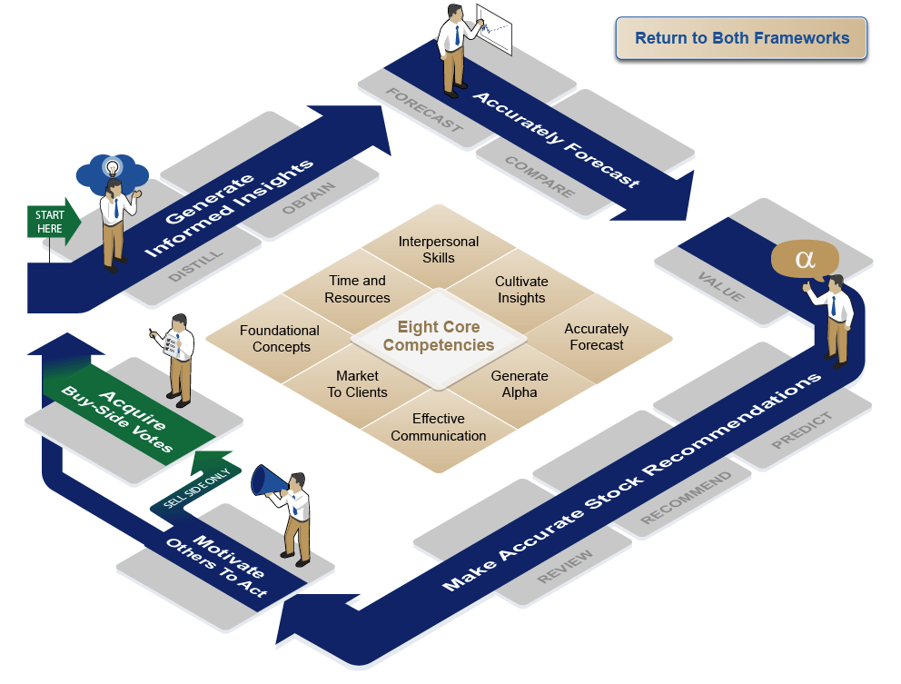
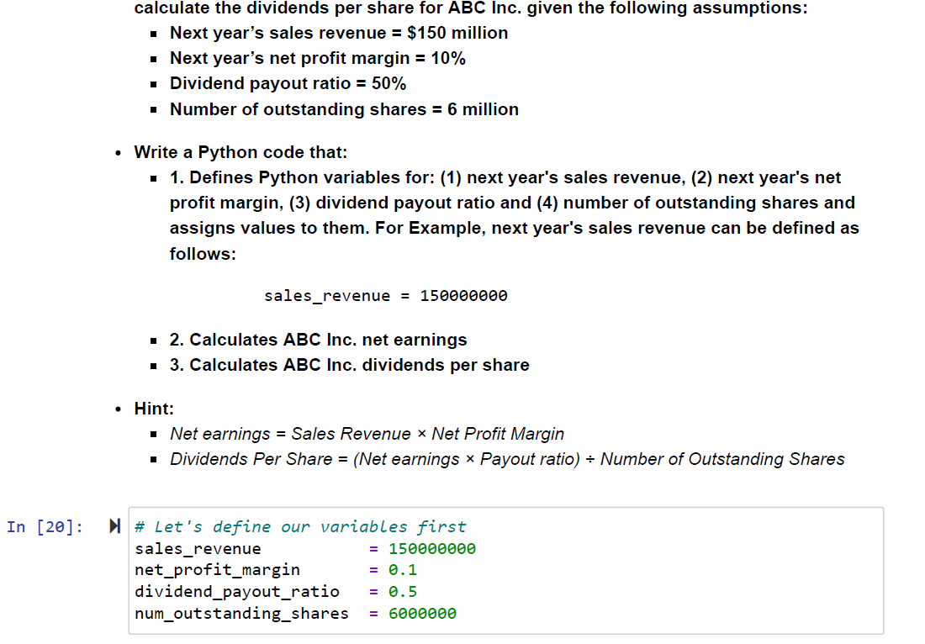
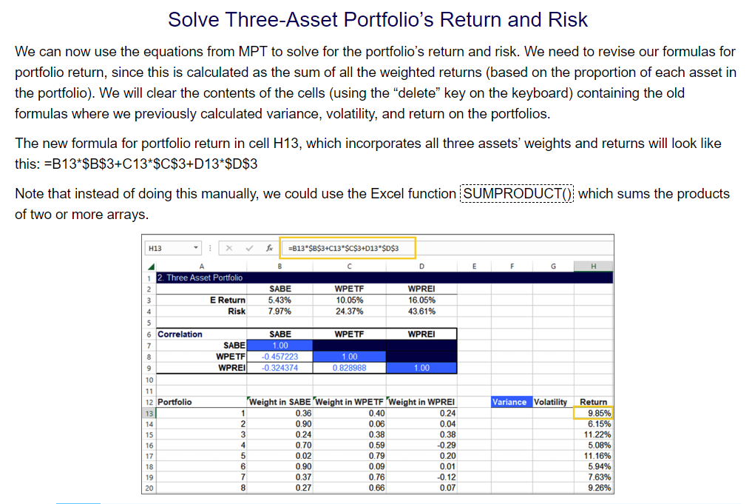
Practical Skills Modules - Topics Covered
Level I
Level II
Level III
Financial Modeling
  Revenues
  Costs
  Depreciation
  Income Tax
  Working Capital
  Capital Structure
  Financial Statements
  Outputs
Python Programming Fundamentals
  Environmental Setup
  Variables
  Data Types
  Comparison Operators
  Conditional Statements
  Loops
  Functions
  Pandas
  Portfolio Optimization
Analyst Skills
  Critical Factors of a Stock
  Generating Insights
  Choosing Valuation Methodology
  Target Prices
  Communicating Stock Calls
  Time and Information Management
Python, Data Science & AI
  Financial Data Scraping, Wrangling, Cleaning
  Dividend Payout Predication Using Machine Learning Regression & Artificial Neural Networks
  Edgar Data Ingestion & Sentiment Analysis Using AWS Comprehend and LSTM Neural Networks
Portfolio Development and Construction
  Investment Policy Statement
  Data Analysis
  Strategic Asset Allocation
  Capital Markets Expectations
  Sensitivity analysis
  Performance Evaluation
© 2025 CFA Institute. All Rights Reserved.

Slide 16
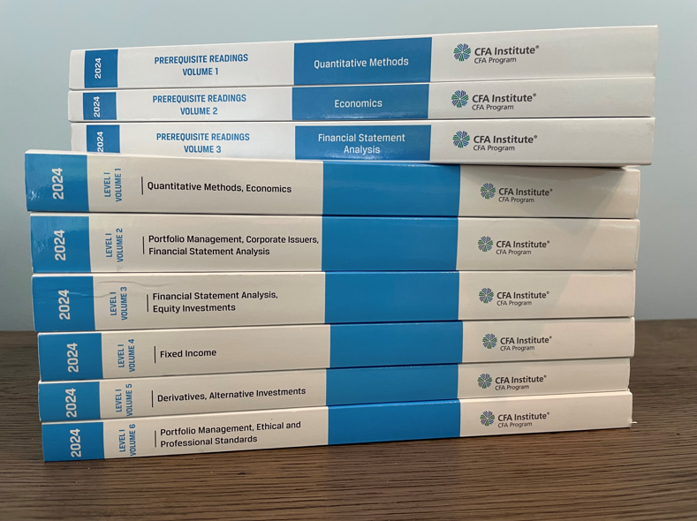

Slide 17
Practice Packs for Level I & II
Additional Mock Exams Includes mock exams replicating the difficulty, length, and topics of the actual exam Written by the same teams who create the real exam Level I: 5 additional mock exams Level II: 3 additional mock exams | Exam Day Simulation: Mock Exam Build confidence with an extra mock exam using the same Prometric software and time constraints as exam day | Extra Practice Questions Test your knowledge with exam-quality questions sorted by curriculum topic Written by CFA Program exam writers Level I: 1,000 questions Level II: 750 questions

Slide 18
CFA® Level III—from 2025:
Core Curriculum + Specialized Pathways
LIII Core curriculum provides knowledge and skills which are key across all three Pathways: Portfolio Management, Private Markets, and Private Wealth.
LIII Core Curriculum (65%-70% of LIII exam)
Portfolio
Management
Pathway
Private
Markets
Pathway
Private
Wealth
Pathway
Or
Or
© 2025 CFA Institute. All Rights Reserved.
Notes:
All candidates take the CORE curriculum. Then, they have their choice of “Specialized Path”
Having specialized paths allows us to cover key job roles in the investment management industry
Candidates can choose the path they are most interested in. However, there is only 1 CFA Charter

Slide 19
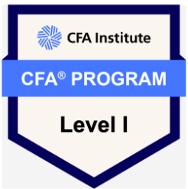
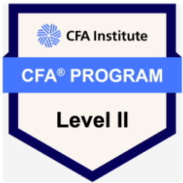
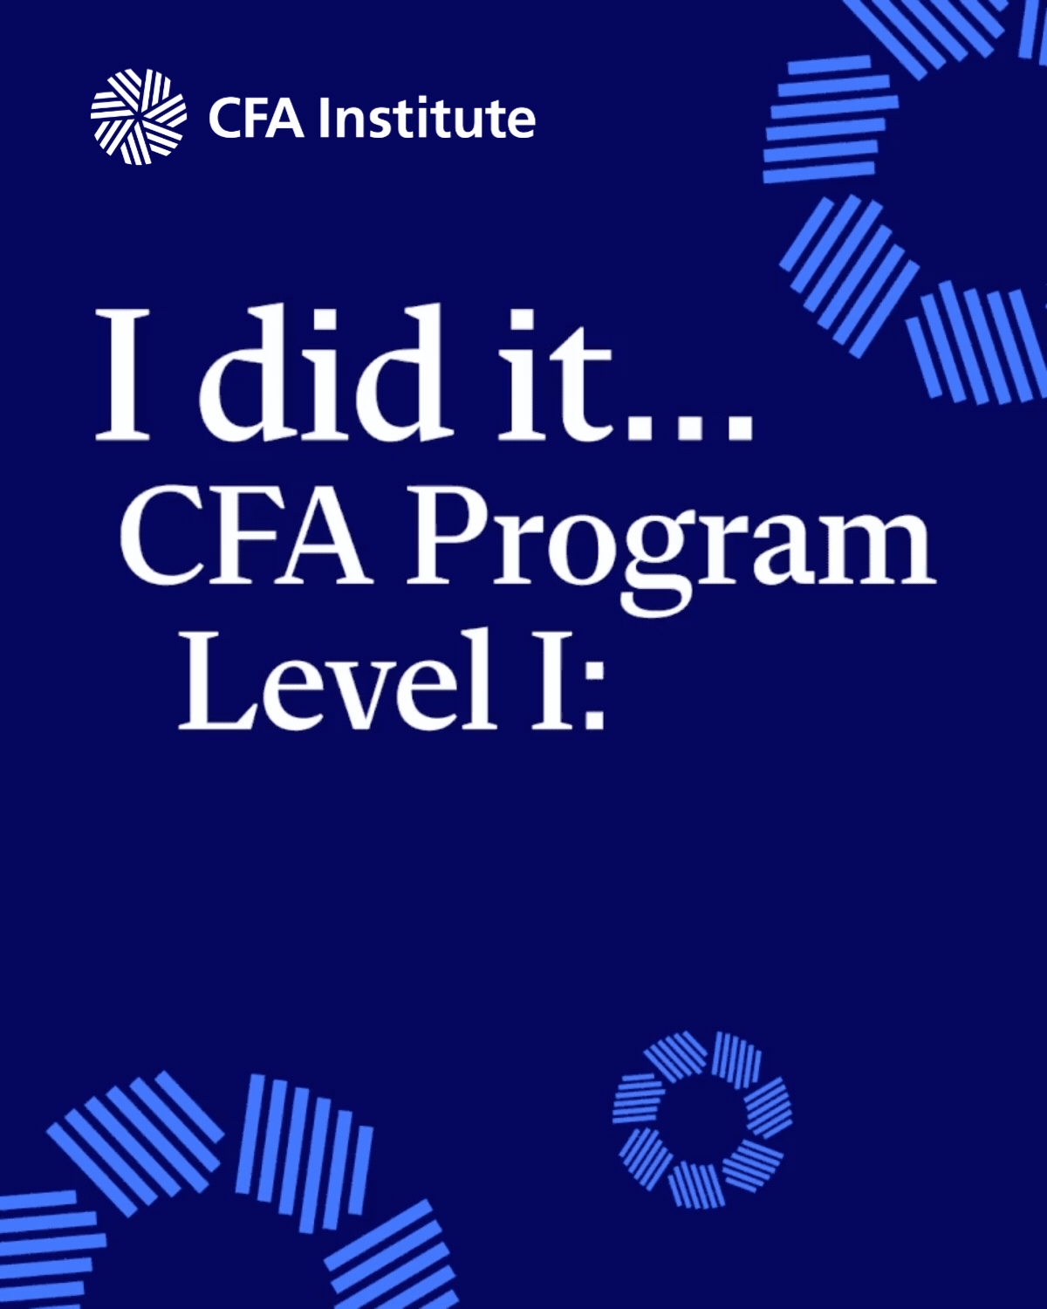
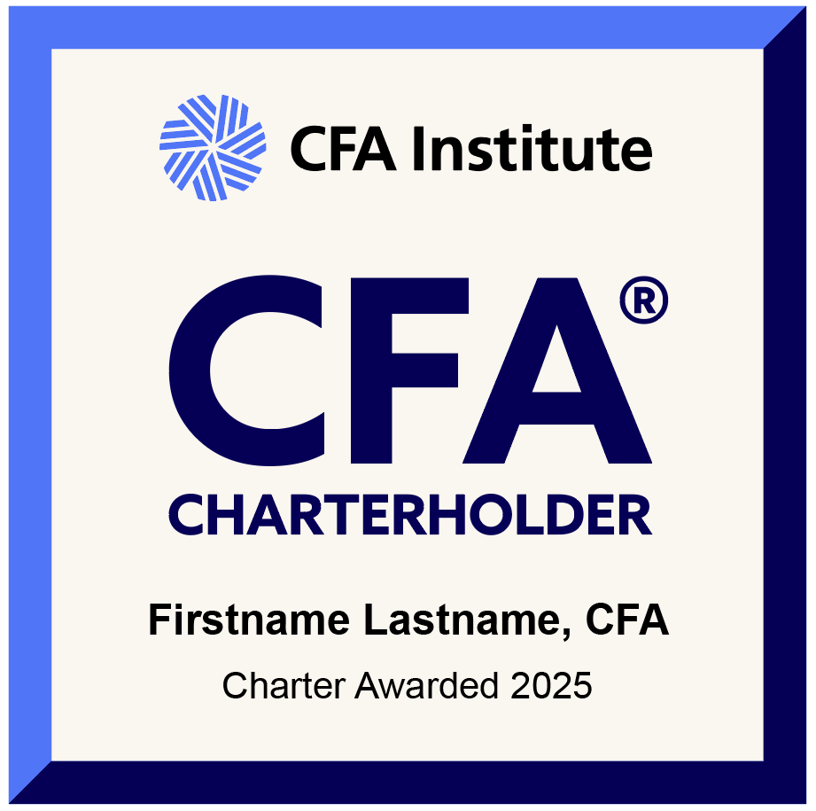
Share your success!

Slide 20
Questions?

