Slide 1
The Changing Rules of Distress: Liability Management and the Future of Chapter 11

Slide 2

Negisa Balluku
Senior Litigation Analyst
Bloomberg Intelligence

Slide 3
LME Landscape

Slide 4
Liability Management Exercises – Then & Now
“Distressed companies [seeking] innovative ways to improve their financial position.”
In re Serta Simmons Bedding, LLC, No. 23-20181, 2024 WL 5250365 (5th Cir. Dec. 31, 2024)
Creative (& aggressive) manufactured out-of-court transactions
Covenant-Lite loan structures resulted in proliferation of “lender-on-lender violence”
Current Generation of LMEs: Shift from a “winners-vs-losers” approach to a more collaborative & “friendlier” environment
LME Flavors
Non-Pro Rata Uptier (Serta, Incora, Robertshaw, Mitel)
Drop-Down (J. Crew)
Double-DIP Drop-Down (At Home, Wheel Pros)
Pari-Plus Drop-Down (Sabre, Trinseo)
Inside-out
Post-LME:
Debt documents reflect new & tighter protections
Yet many roads lead to bankruptcy court!

Slide 5
Competing & Complementary Goals
Company/Sponsor
Participating Creditors
enhanced economics
and/or collateral
control over future
bankruptcy
tightened debt docs
and market protections
extend maturities
preserve equity value
reduce near-term cash
interest expense
extend operational runway
avoid/delay bankruptcy

Slide 6
Language Matters: Serta
Non-Pro Rata Contractual Uptier
Sacred Right: Pro-rata mechanism
Benefit: No move of assets; no disruption of operations
Limited availability
  Serta Blockers
  Open market purchase exception no longer helpful in 5th Circuit
“[E]ach Borrowing, each payment or prepayment of principal of any Borrowing, each payment of interest in respect of the Loans of a given Class and each conversion of any Borrowing . . . shall be allocated pro rata among the Lenders in accordance with their respective Applicable Percentages of the applicable Class.”
Serta First Lien Term Loan 2016 Agreement, § 2.18
“[A]ny Lender may, at any time, assign all or a portion of its rights and obligations under this Agreement in respect of its Term Loans to any Affiliated Lender on a non-pro rata basis (A) through Dutch Auctions open to all Lenders holding the relevant Term Loans on a pro rata basis or (B) through open market purchases . . . .”
Serta First Lien Term Loan 2016 Agreement, § 9.05(g) (emphasis added)

Slide 7
Language Matters: Mitel & STG Logistics
“The breach of contract claims (second through sixth causes of action) should also be dismissed. The subject transaction did not breach §§ 2.18(c) and 9.04(b)(ii)(D) because it complied with the express exception to these provisions located at § 9.04(i). This provision authorizes the borrower to "purchase by way of assignment and become an Assignee with respect to Term Loans at any time." The parties dispute whether the subject transaction represented a "purchase" or simply a "refinancing" or "exchange" of the existing loans for new loans. However, these concepts are not mutually exclusive. There is no indication in the agreements that a refinancing or exchange cannot include a purchase, nor is there any indication that a purchase requires payment in full, upfront, in cash, or that debt cannot constitute payment. Indeed, several provisions suggest otherwise.”
Ocean Trails CLO VII v. MLN Topco Ltd., Case No. 2024-00169 (N.Y. App. Div., 1st Dep't, Dec. 31, 2024) (emphasis added)
“[T]he Court distinguishes the instant facts from those in Mitel: here, the crux of Plaintiffs’ allegations are that Defendants’ amendments to the FAA flew in the face of their reasonable expectations of negotiated lender protections in the FAA in contrast to Mitel, where the parties did not specifically negotiate amendments to prohibit the contested transaction.”
Axos Financial, Inc. v. Reception Purchaser, LLC, No. 650108/2025, 2026 WL 27202 ( Sup. Ct. N.Y. Cnty. Jan. 03, 2026)

Slide 8
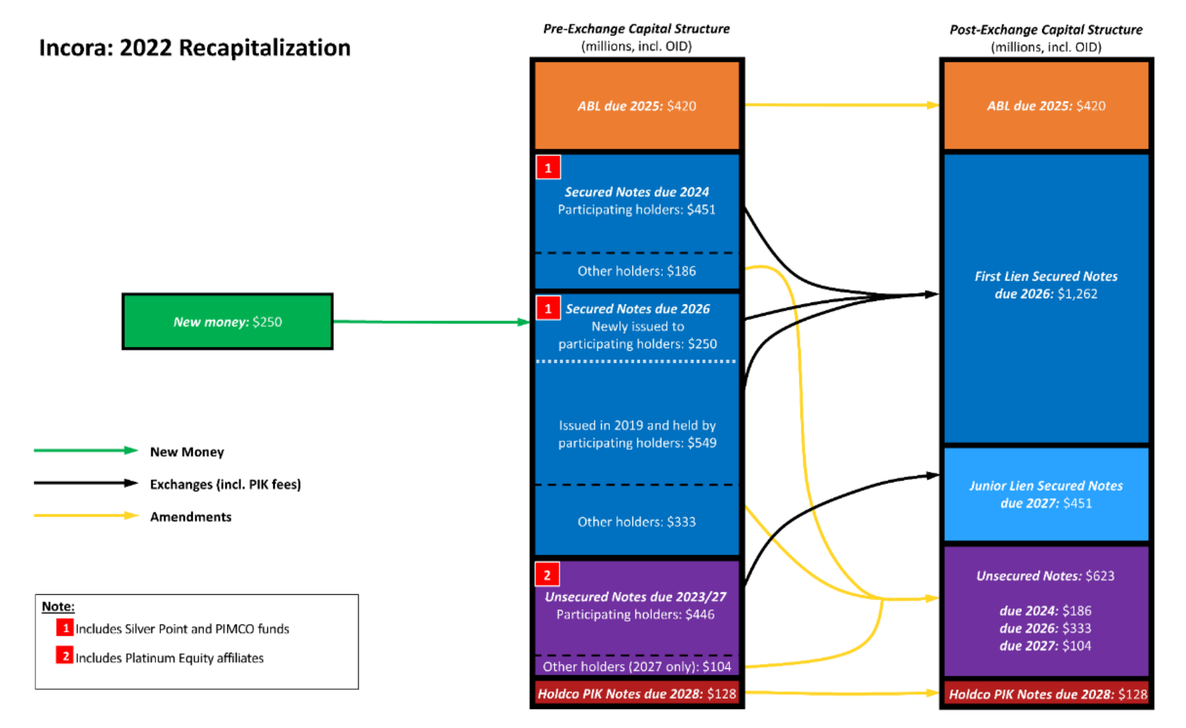
Language Matters: Incora
2022: Incora receives the required majority vote to pursue an initial change to the indentures, authorizing $250 million of new secured notes maturing in 2026
Including the new notes in the tally, the company obtained more than 2/3 of the votes needed to release the collateral under the original secured indentures, rendering the once-secured notes unsecured
At issue: Indenture language blocking amendments that “have the effect of releasing” collateral; transaction’s automatic nature
Wesco Aircraft Holdings, Inc. v. SSD Investments Ltd., Case 23-03091; Dkt. No. 1
“In addition, without the consent of the Holders of at least 66 2/3% in aggregate principal amount of the 2026 Secured Notes then outstanding (including, without limitation, consents obtained in connection with a purchase of, or tender offer or exchange offer for, the 2026 Secured Notes), no amendment, supplement or waiver may (1) have the effect of releasing all or substantially all of the Collateral from the Liens created pursuant to the Security Documents (except as permitted by the terms of this Indenture, the Security Documents or the Intercreditor Agreements) or changing or altering the priority of the security interests of the Holders of the 2026 Secured Notes in the Collateral under the ABL Intercreditor Agreement or the Pari Passu Intercreditor Agreement . . . .”
Incora 2024/2026 Indenture, § 9.02; Also see Wesco v. SSD Investments, Report and Recommendation, Jan. 17, 2025, Case 23-03091, Dkt. No. 1520 (emphasis added)

Slide 9
On Remedies…
Robertshaw: Money damages against bankruptcy estate
Incora: Bankruptcy Court restored excluded noteholders’ liens to their pre-LME status; district court reversed
  “The 2026 Noteholders’ rights and liens remained effective according to their terms notwithstanding the 2022 Transaction.”
  Wesco v. SSD Investments, Report and Recommendation dated Jan. 17, 2025, Case 23-03091, Dkt. No. 1520
Serta: Excision of plan indemnity provision opens door for excluded lenders to pursue claims against participating lenders post-LME unraveling
  Disparate treatment & recovery under Serta’s Chapter 11 plan confirmed in 2023: Limited availability
    $879.9 million term-loan claims held by the nonparticipating lenders: 0.6-2.4%
    $843.4 million of first-lien second-out claims held by participating lenders: 73.7-75.6%
    General unsecured claims: 0-3.3%

Slide 10
Cases to Watch
Case | Court | Brief History | Status
In re Serta Simmons Bedding, L.L.C. | U.S. Bankruptcy Court Southern District of Texas | Dec. 31, 2024: US Court of Appeals for the 5th Circuit issues ruling rejecting 2020 LME | Bankruptcy Court to address indemnification obligations of participating lenders (decision pending)
Wesco Aircraft Holdings, Inc. v. SSD Investments Ltd. (Incora) | US Court of Appeals for the 5th Circuit | July 10, 2024: TX Bankruptcy Court rules that 2022 LME violated underlying agreements Sept. 11, 2025: District Court reverses Bankruptcy Court | Proceedings ongoing
Deltroit Directional Opportunities Master Fund Limited v. Selecta Group B.V. | U.S. District Court for the Southern District of New York | Oct. 28, 2025: Case Filed | Proceedings ongoing
Optimum Communications, Inc. v. Apollo Capital Management, L.P. | U.S. District Court for the Southern District of New York | Nov. 25, 2025: Case Filed | Proceedings ongoing

Slide 11
LME Tools
Issuer/Sponsor
Lenders
Co-ops: A Creditor’s Survival Tool
Anti-Coop Provisions
Anti-Boycott Provisions
Antitrust Challenges to Co-ops
Disqualified Lender (DQ) Lists
Disqualified Counsel Lists
Restrictive NDAs
Threat of Deal-Away
Cooperation Agreements
Omni-Blockers
Blockers: Serta, J. Crew etc.
Reputational Risk: sword and shield
Co-ops in Offensive & Defensive Strategies
Considerations:
  Additional debt subject to co-op terms
  Limitations on sales/transfers/exiting positions
  Disparate treatment of initial v. subsequent parties
  Length, formation, termination & extensions
  Prohibition on communications with borrower
  Enforceability of specific performance remedy provisions
Less effective in preventing drop-down LMEs

Slide 12
LME Tools (cont’d)
Issuer/Sponsor
Prohibition Regarding Cooperation Agreements
Lenders
Anti-Coop Provisions
Anti-Boycott Provisions
Antitrust Challenges to Co-ops
Disqualified Lender (DQ) Lists
Disqualified Counsel Lists
Restrictive NDAs
Threat of Deal-Away
Cooperation Agreements
Omni-Blockers
Blockers: Serta, J. Crew etc.
Reputational Risk: sword and shield
No restricted party at the time of entering into the agreement, or after, will enter into or is party to a cooperation agreement. If a lender violates this provision, such lender will forfeit its right to receive payment “on all Obligations held by such Lender.”
Amended and Restated Credit Agreement, dated as of January 12, 2026, by and among Cablevision Litchfield, LLC and CSC Optimum Holdings, LLC, each as a borrower, the guarantors party thereto, the lenders party thereto and JPMorgan Chase Bank, N.A., as administrative agent and collateral agent § 9.23

Slide 13
LME Tools (cont’d)
Anti-Boycott Provision
Each Holder, Notes Beneficial Owner and any affiliate of the foregoing persons (other than Screened Affiliates) (such persons, the “Subject Persons”) is prohibited from entering into or becoming subject to or bound by any boycott agreement, cooperation agreement, support agreement, lock-up agreement, coordination agreement or other similar agreement that restricts, limits, conditions or otherwise prohibits in any manner any Subject Person party thereto or otherwise bound thereby from (i) purchasing for cash any newly-issued debt or securities issued by the Parent Guarantor and its Subsidiaries or (ii) making any loans in cash to the Parent Guarantor and its Subsidiaries, in the case of clauses (i) and (ii), from time to time after the date hereof (the “Boycott Agreement”). Moreover, any person that is party to or otherwise bound by a Boycott Agreement is prohibited from purchasing or otherwise acquiring the Notes.
Third Supplemental Indenture to Indenture for 4.302% Senior Notes due 2030 and 4.693% Senior Notes due 2033 among WarnerMedia Holdings, Warner Bros. Discovery, Subsidiary Guarantors, and U.S. Bank Trust Company, § 3.06(a)
Issuer/Sponsor
Anti-Coop Provisions
Anti-Boycott Provisions
Antitrust Challenges to Co-ops
Disqualified Lender (DQ) Lists
Disqualified Counsel Lists
Restrictive NDAs
Threat of Deal-Away

Slide 14
LME Tools (cont’d)
Antitrust Challenges to Co-ops
“When these creditors decry “creditor-on-creditor violence,” they are really just articulating the traditional logic of a cartel: the belief that collusion between rivals yields better outcomes for those in the cartel.”
Optimum Communications, Inc. v. Apollo Capital Management, L.P., Complaint, Case No. 25-09785 (S.D.N.Y. 2025)
“Describing the Restructuring as both “coercive” and “invidious,” numerous industry publications and commentators have called out the Favored Holders for hiding the details of their negotiations, preventing other 1L Holders from joining their group, and forcing the Excluded Holders to choose between near worthless 3O Notes or the elimination of their sacred rights. Taken together, these steps constitute a striking (and disturbing) example of ‘creditor-on-creditor violence.’”
Deltroit Directional Opportunities Master Fund Limited et al v. Selecta Group B.V., Complaint, Case No. 25-08956 (S.D.N.Y. 2025)
Issues of “first impression” can be very unpredictable
Applicable case law is extremely limited, but suggests antitrust injuries don’t apply to exercises touching upon the collection of pre-existing debt
  Falstaff Brewing Corp. v. New York Life Ins. Co., 513 F.Supp. 289 (N.D. Cal. 1978)
  Sharon Steel Corp. v. Chase Manhattan Bank, 691 F.2d 1039 (2d Cir. 1982)
  United Airlines, Inc v. U.S. Bank N.A., 406 F.3d 918 (7th Cir. 2005)
Issuer/Sponsor
Anti-Coop Provisions
Anti-Boycott Provisions
Antitrust Challenges to Co-ops
Disqualified Lender (DQ) Lists
Disqualified Counsel Lists
Restrictive NDAs
Threat of Deal-Away

Slide 15
Chapter 11 – Recent Developments

Slide 16
“In-Court” Liability Management Exercises

Slide 17
DIP Financing Developments
DIP Roll-Ups
DIPs as Sub Rosa Plans
DIPs & Adequate Protection
Roll-up: DIP feature that converts prepetition debt into post-petition debt; no longer controversial
New Money to Rolled Up Debt ratio range: 1:1 to 1:4
Non-Pro Rata Roll-Ups: Controversial arrangement where only a select group of prepetition lenders are allowed to roll-up their prepetition debt into senior liens/superpriority status
Sub Rosa Plan Prohibition: DIP financing terms may not predetermine plan outcomes & terms or circumvent Chapter 11 creditor protections
In re LATAM Airlines Grp. S.A., Case No. 20-11254 (Bankr. S.D.N.Y. 2020): DIP equity conversion feature rejected because it represented an impermissible sub rosa Chapter 11 plan
Equity conversion feature approved where no objection was filed or no alternative DIP financing was available. See Avianca Holdings, Grupo Aeromexico, SAS AB
Section 364(d) of the Bankruptcy Code: debtor may obtain DIP secured by a lien senior or equal to an existing lien, so long as the existing lienholders receive adequate protection.
When a party with a disputed interest in collateral asserts a right to adequate protection, the creditor need only make a prima facie showing of a valid security interest to be entitled to adequate protection. First Brands, Case No. 25-90399 (Bankr. S.D. Tex. 2025)

Slide 18
DIPs as the New “In-Court” LMEs
In re Del Monte Foods Corp. II, Inc., Case No. 25-16984 (Bankr. D.N.J. 2025): neither the new post-petition loan obligations nor the improved treatment of the participating lenders’ pre-petition loans resulting from the roll-up constituted a “payment” or “reduction” of debt because it involved a cashless exchange
In re American Tire Distributors, Inc., Case No. 24-12391 (Bankr. D. Del. 2024): Won’t rubber stamp non pro rata DIP rollups and a rollup can be considered a paydown of prepetition debt, even if it is technically a cashless exchange.
In re ConvergeOne Holdings, Case No. 24-90194 (Bankr. S.D. Tex. 2024), Case No. 24-02001 (S.D. Tex. 2024) : The District Court reversed, finding the plan resulted in unequal treatment among creditors in the same class and therefore violated Section 1123(a)(4) because participation in the backstop was not offered to all class members, nor was the investment opportunity market tested.
Key Takeaways:
  Drafting matters: bankruptcy courts will scrutinize rollups and whether such arrangements violate the pro rata sharing provisions of prepetition credit agreements
  Case law is still developing: written opinions addressing non pro rata DIP rollups are limited; courts aren’t always aligned
  Impact of Section 1123(a)(4) of the Bankruptcy Code: Arrangements that give only certain class members an opportunity to contribute new value that provides them with a greater recovery than other class members may violate the Bankruptcy Code’s prohibition against disparate treatment among creditors in the same class
  Most disputes conclude in settlement

Slide 19
Post-Purdue: Third Party Releases

Slide 20
The Meaning of “Consent”
Bankruptcy Code does not authorize non-consensual third-party releases. Harrington v. Purdue Pharma, L.P., 603 U.S. 204 (2024)
 | 2nd Circuit | 3rd Circuit | 5th Circuit
Consensual Third-Party Releases | Opt-Outs generally permissible, but may only bind parties that return ballot Adequate notice needed Third-party releases cannot bind parties that are “deemed rejecting” Relevant Cases: In re Spirit Airlines, Inc., 668 B.R. 689 (Bankr. S.D.N.Y. 2025) In re GOL Linhas Aéreas Inteligentes S.A., 672 B.R. 129 (Bankr. S.D.N.Y. 2025) In re Azul S.A., No. 25-1176, 2026 Bankr. LEXIS 18, at *24-25 (Bankr. S.D.N.Y. 2026) | District of Delaware: no single approach; courts generally skeptical of opt-outs District of New Jersey: opt outs are permissible Relevant Cases: In re Smallhold, Inc., 665 B.R. 704, (Bankr. D. Del. 2024) Corvias-Campus Living– USG, LLC, 25-11214 (Bankr. D. Del. 2025) WEH Liquidating, LLC, No. 25-11602 (Bankr. D. Del. 2025) In re Lumio Holdings, Inc., Case No. 24-11916 (Bankr. D. Del. 2025) | Opt-outs are generally permissible, except when a party will receive no recovery under a plan; may or may not be permissible when a party is not expected to receive a meaningful recovery under a plan Relevant Cases: In re Robertshaw US Holding Corp, 662 B.R. 300 (Bankr S.D. Tex. 2024) In re Wellpath Holdings, Inc., No. 24-90533 (Bankr. S.D. Tex. 2025) In re The Container Store Group, Inc., No. 4:25-cv-00618 (S.D. Tex. 2025)

Slide 21
Today’s Fraud
"I probably shouldn't say this, but when you see one cockroach, there are probably more.“ Jamie Dimon, JPMorgan Chase

Slide 22
First Brands Group – Case Study
Debt Outline
Key Themes
Case Outline
Total Secured Debt: $9.3 Billion
Alleged Factoring Fraud: $2.3 Billion
DIP Loan: $1.1 Billion
Same collateral pledged to multiple lenders
Line between defrauded creditor and complicit one hard to draw, raising standing, priority and litigation questions
Depth of fraud harder to discern early in the case
Exclusively the province of bankruptcy courts; limited governmental involvement
Sep 2025: Chapter 11 petition filed; $1.1 Billion DIP financing secured, initially signaling reorganization potential
Jan. 2026: Patrick and Edward James criminally indicted
Early 2026: Case pivots to liquidation
Pending:
  Recoveries reliant on litigation trust established to pursue estate causes of action
  Chapter 11 plan yet to be confirmed

Slide 23
Q&A

Slide 24
Thank you
Contact the Bloomberg Intelligence Analysts
Negisa Balluku, Senior Bankruptcy Litigation Analyst, nballuku4@bloomberg.net

Slide 25
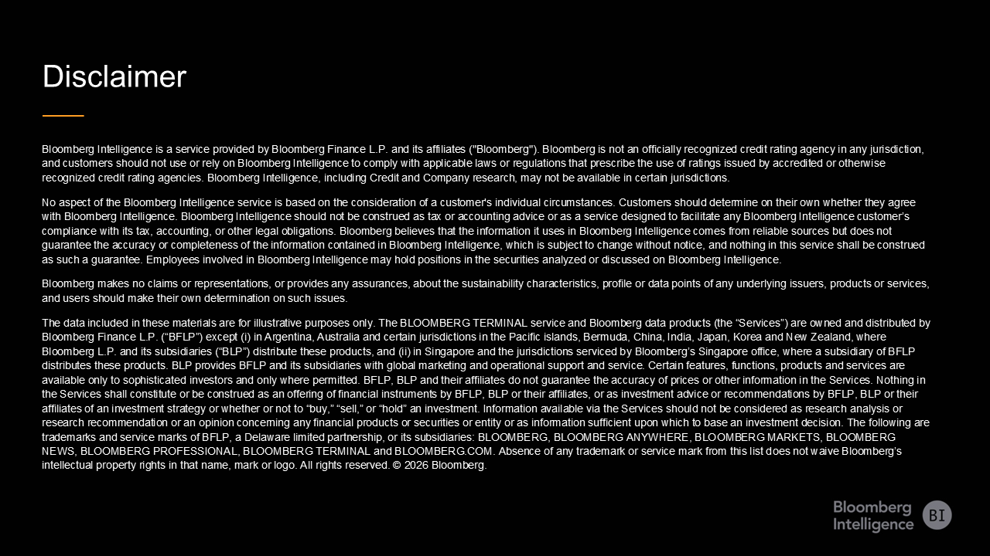
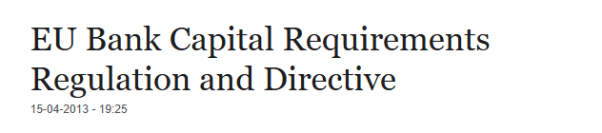

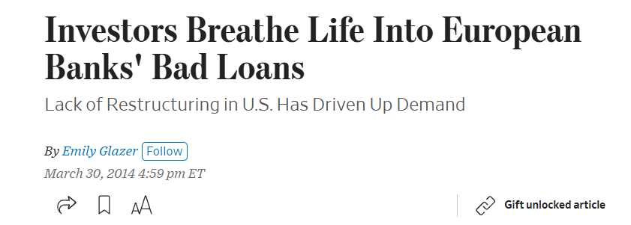
#4: 2007-2020: Post-Crisis and Deepening Entanglement

