Slide 1
The High Yield Market
& the Electronic Trading Advantage
Patrick Lenhart, CFA Regional Head of Sales, Boston, MarketAxess
June 2026

Slide 2
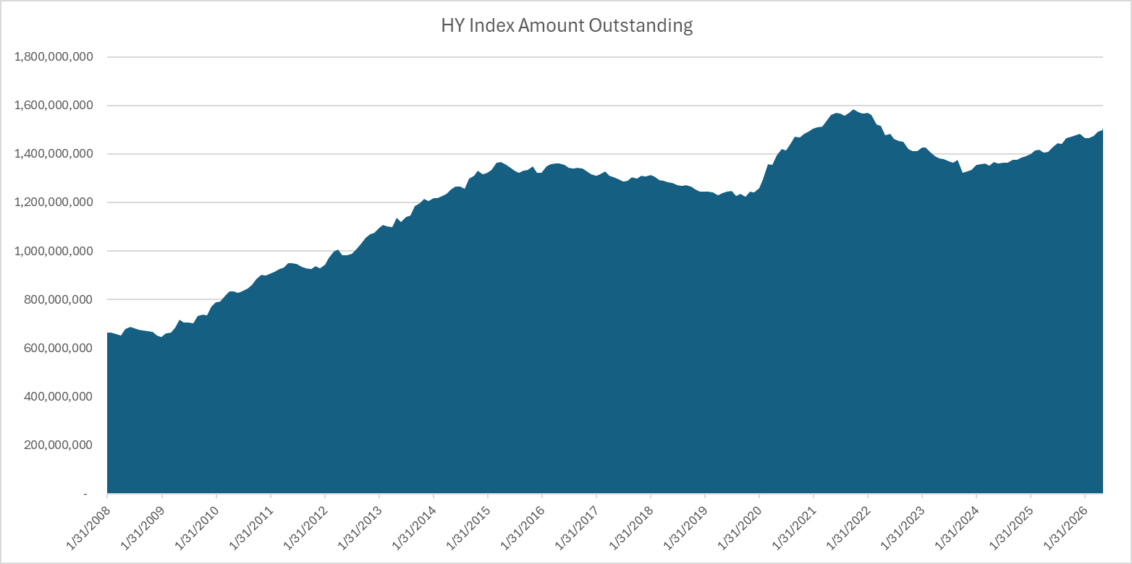
Since 2008, the High Yield Market has a little more than doubled....

Slide 3
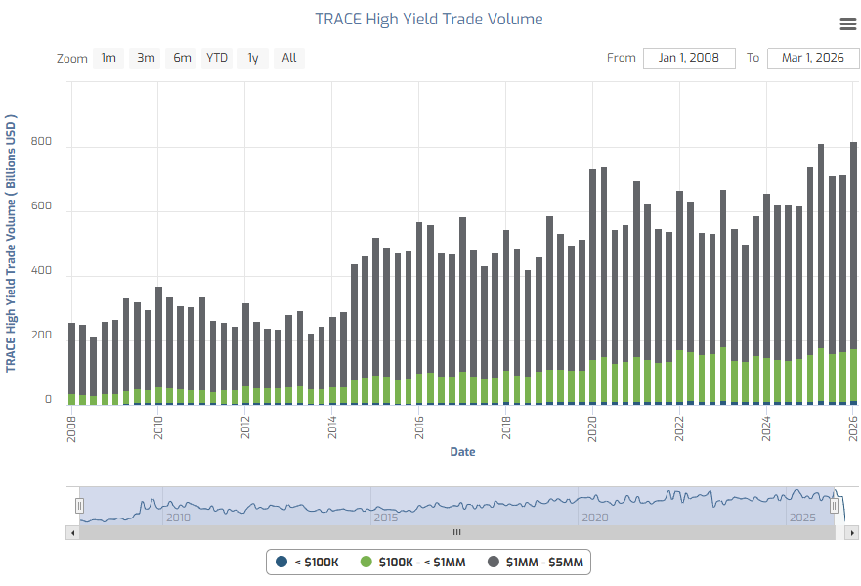
...while Quarterly HY trade volume is up more than 4x (HY ADV $3bn --> $13bn)

Slide 4
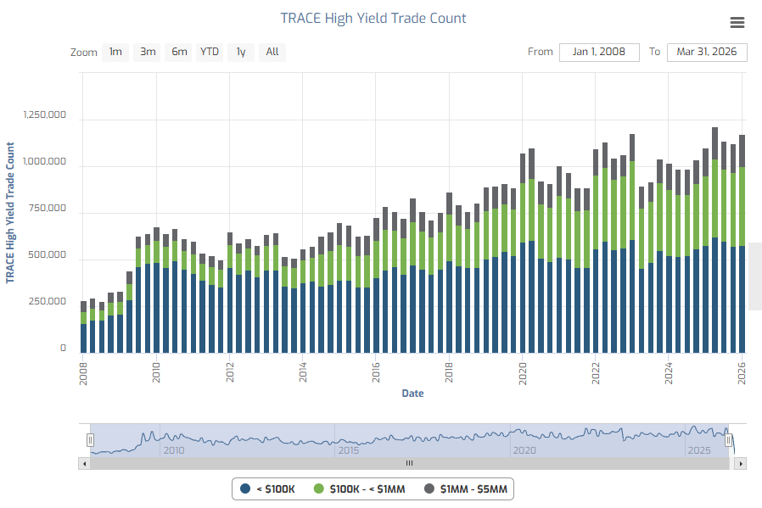
...and HY trade count has also grown more than 4x

Slide 5
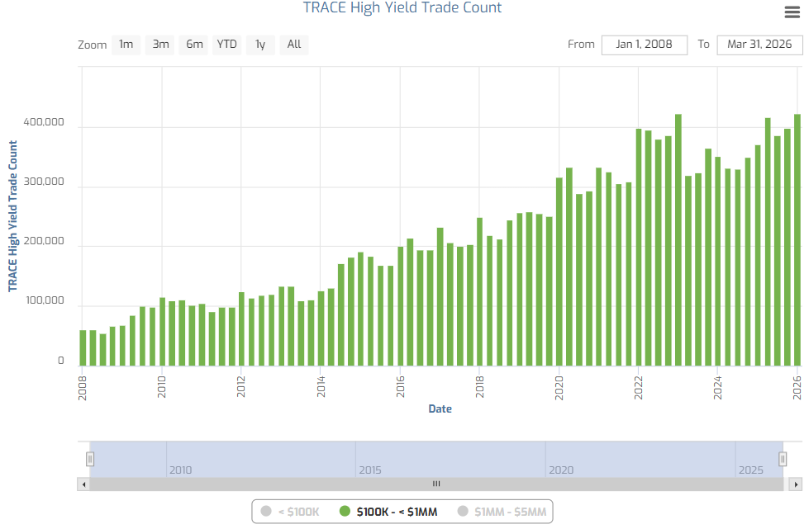
HY trade count in $100K-$1MM sizes up by more than 6x (less than 1k/day --> 6k+)

Slide 6
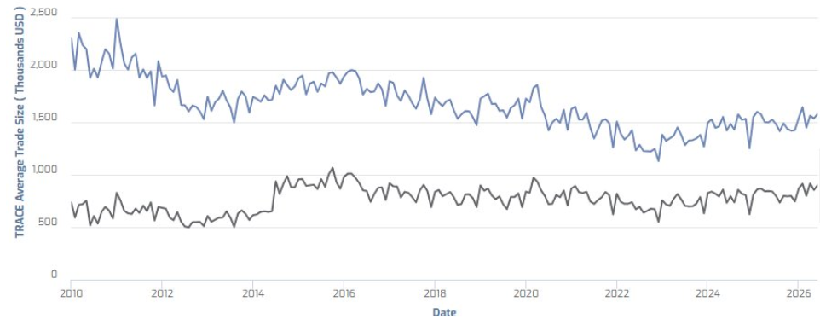
High Yield since 2008 by the numbers.... turnover > growth
 | 1Q 2008 | 1Q 2026 | YoY
HY Index Amount Outstanding | $664 BN | $1.5 Trillion | ↑227%
HY ADV Trade Volume | $3.0 BN | $13.2 BN | ↑440%
HY Quarterly Trade Count | 250,000 | 1.2 MM | ↑480%
HY Quarterly Block Count (1MM-5MM) | 58,000 | 175,000 | ↑301%
HY Average Trade Size | $750,000 | $850,000 | ↑13%

Slide 7
Electronic trading levels - U.S. corporate bonds
Notes:
On the surface, the overall electronification of both HY and IG markets seems to have plateaued.
But the sharp increases in HY Auto-X usage really sets the stage for the next wave, where we see it going from ~30% closer to 50% and more in line with IG.
We think this could happen in the next 12-24 months.

Slide 8
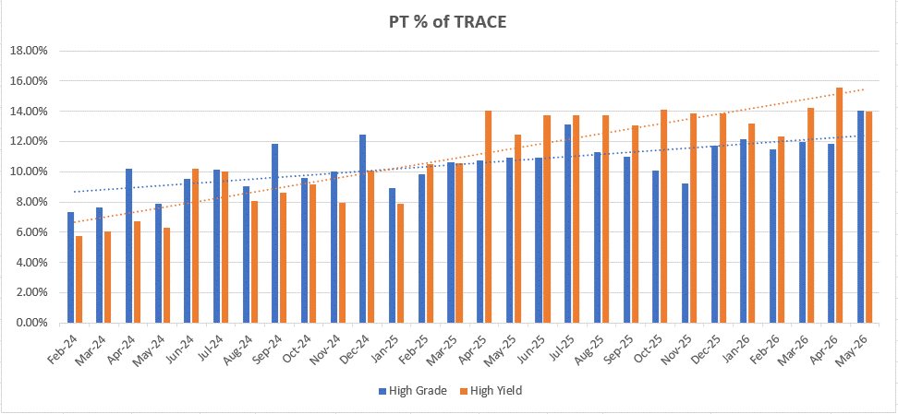
HY Portfolio Trading as % of TRACE (orange) has accelerated rapidly in the past year
      MarketAxess 1Q 2026
Record $112B in HY PT volume, ↑78% YoY $118.7B global PT volume, ↑51% YoY. Average HY PT Trade Size $82 million.

Slide 9
Automation in High Yield is surging, now exceeds IG automation
20.9%
17.9%

Slide 10
Breaking down the 7+ responses per HY inquiry on MKTX (Algos vs OT vs Dealers)

Slide 11
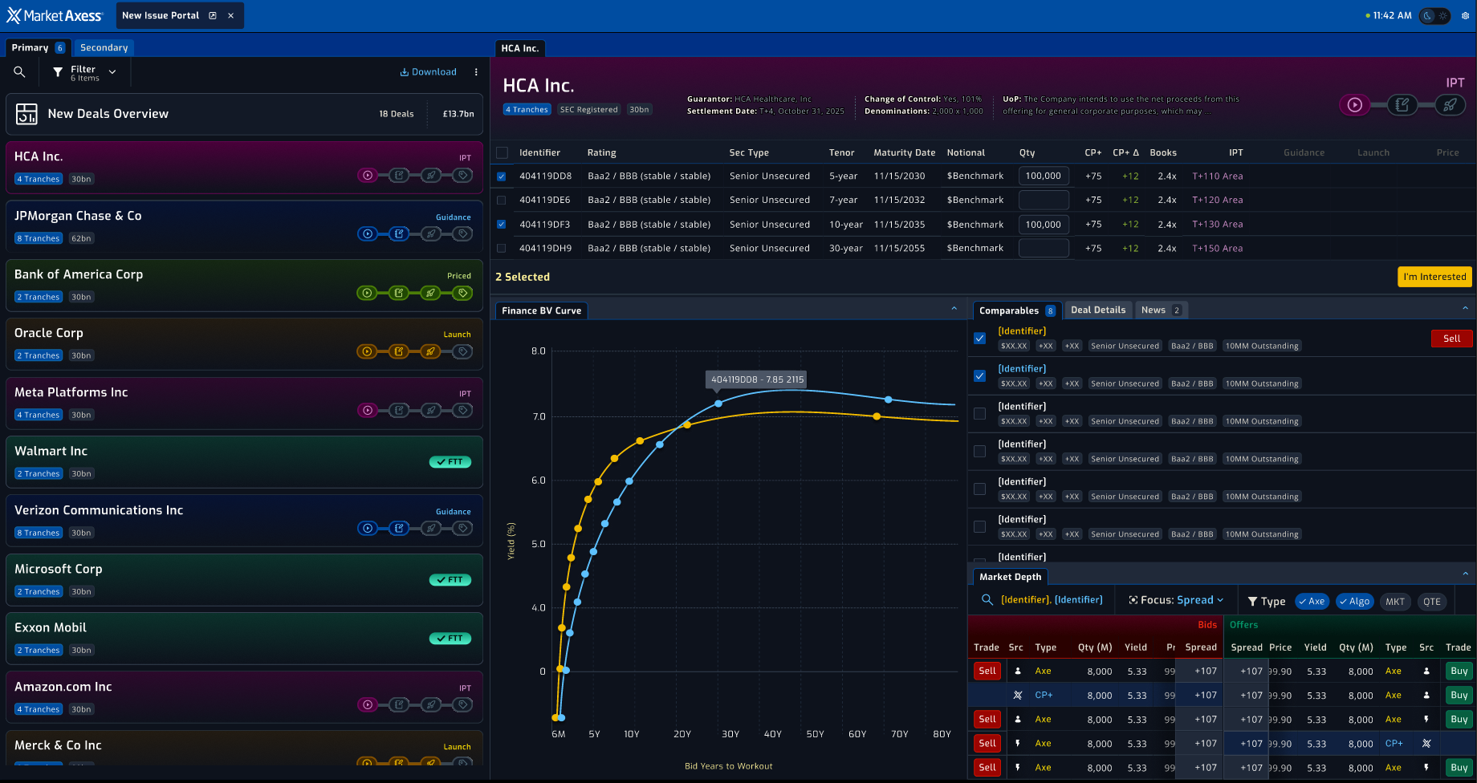
Partnership – Our New Issue Dashboard
*future enhancement*

Slide 12
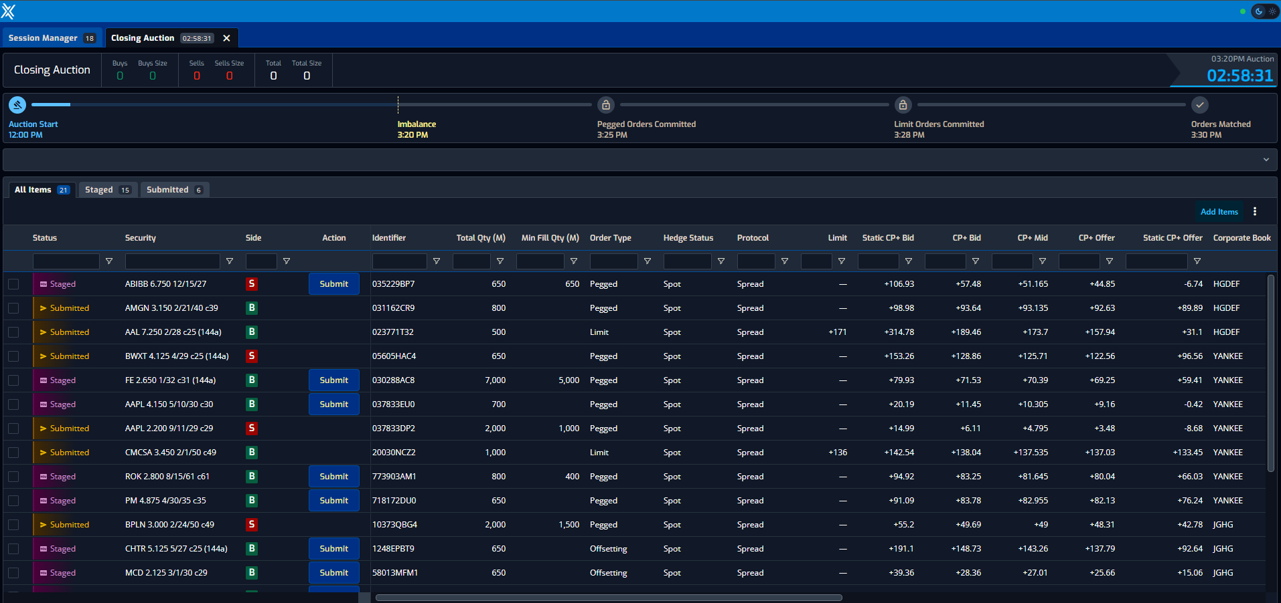
MarketAxess Auctions
      Benefits of an Auction
Reduced tracking error
An auction price, with multiple counterparties, would receive higher priority as an input reducing tracking error.
Consistent price efficiency
Liquidity centralizes on auctions as they are known events that provide a way to offset risk for market makers in ETFs, Swaps, Futures and Options.
Internal Crossing for asset managers
As a multiparty trade with the price determined by market demand, the Auction Price or an Evaluated Price influenced by the Auction could be used for internal crossing*.
      Key Features
All Open Trading clients can participate.
Auctions held twice daily near the open and close of trading.
Multiple order types offered (Pegged, Limit, Offsetting Only).
Must be a participant to receive auction characteristics.
Leverages CP+ to determine outlier pricing bands.
* MarketAxess Auctions and CP+ evaluated prices are not Rule 17a-7 compliant crossing levels and should not be used as such by any fund registered under the 1940 Act or subject to ERISA.

Slide 13
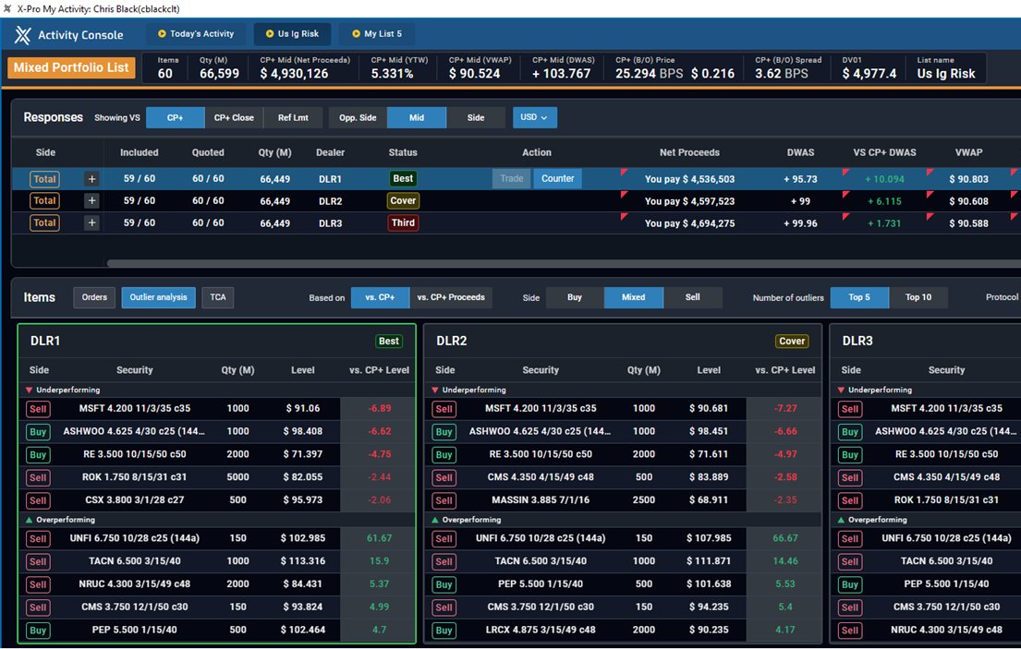
New X-Pro Workstation
      CURRENT FUNCTIONALITY
Multi-market capability for up to 3000 line items.
Bi-Directional trades supported.
In-Competition pricing with up to 10 dealers.
Outlier analysis can be leveraged to quickly view under/over performing bonds vs. CP+.
TCA breaks the list out by sector, duration, credit rating to identify costly pockets of the basket.
Sortable and draggable columns allows users to customize their view and quickly identify outliers
Portfolio Lists allow the inclusion of any EUR or USD denominated US/EM/EU bond.

Slide 14
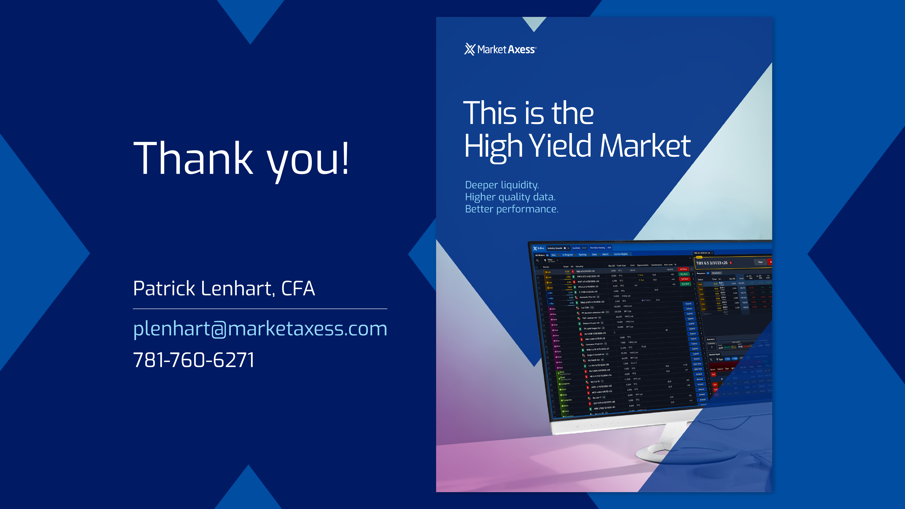

Slide 15
